Slide 1


Regional Report Cards
and the role of GIS
Adam Shand, Environmental Data Analyst
Notes:
Introduce self, from Healthy Waters Partnership for the Dry Tropics.
First, grateful to be in the room with a diverse group of specialists who know the challenges of using GIS in everyday work.

Slide 2
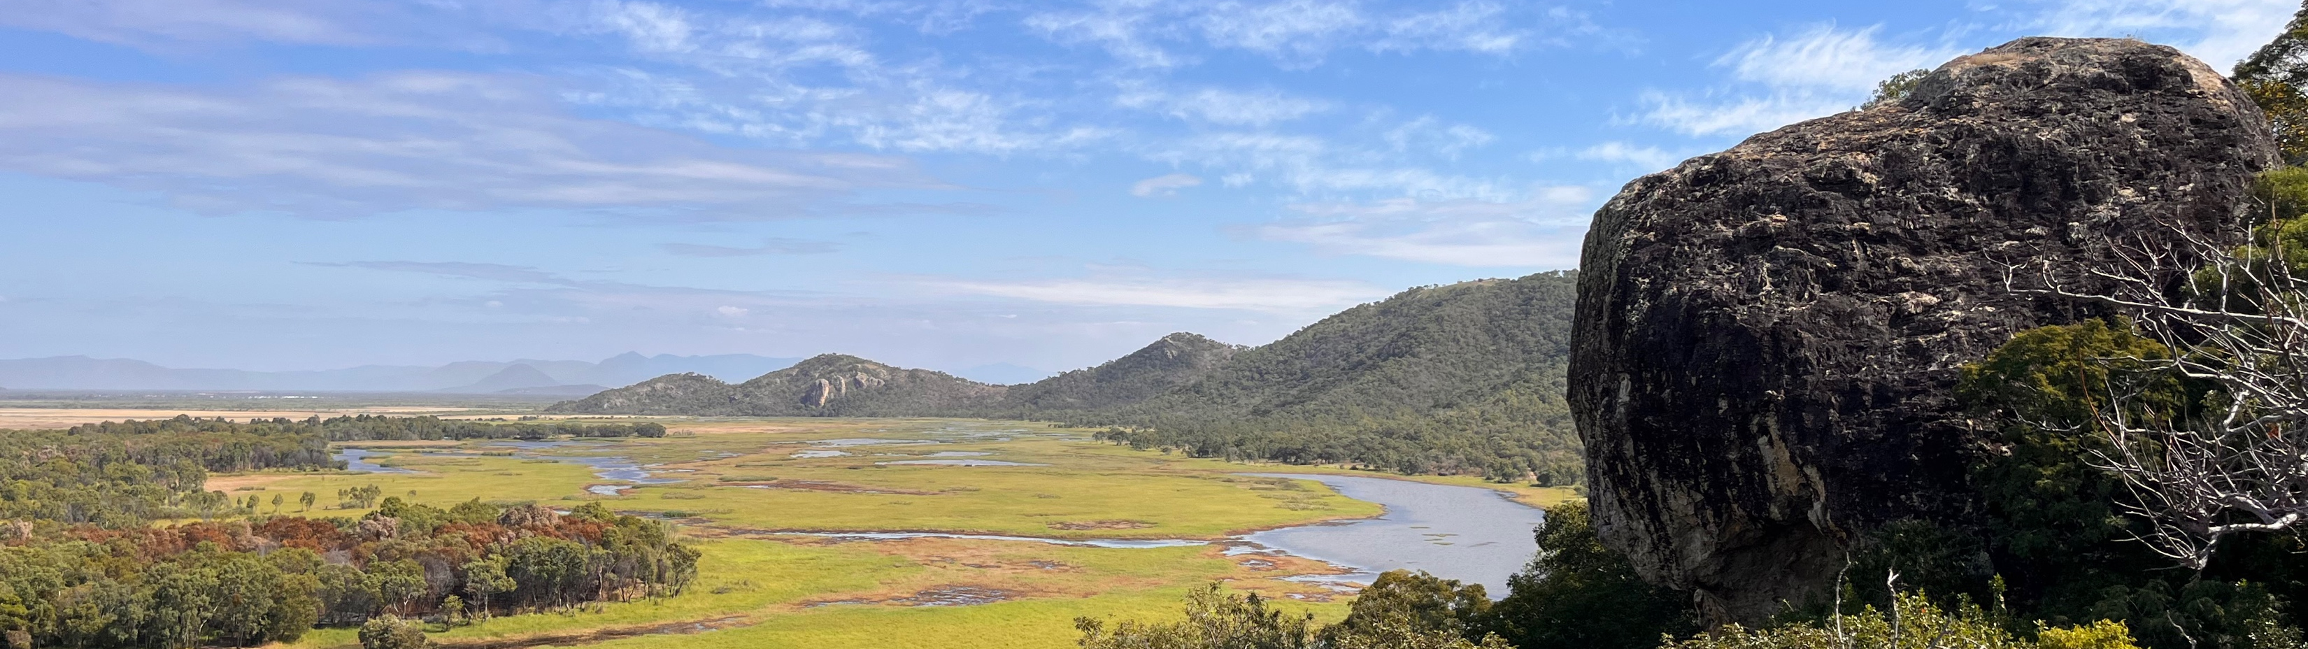
The Healthy Waters Partnership for the Dry Tropics acknowledges the Wulgurukaba, Bindal, Nywaigi, and Manbarra people as the Traditional Custodians of the land and sea country in which we work, and we pay our respects to their Elders, past and present.
Notes:
On behalf of the Partnership I would like to acknowledge the Wulgurukaba, Bindal, Nywaigi, and Manbarra people as the Traditional Custodians of the land and sea country in which we work, and pay my respects to Elders past and present.
And we would also like to extend this acknowledgement to the Gimuy-walubarra (pronounced) ghee-moy-wah-lu-burra people as the Traditional Custodians of the land in which we meet today.

Slide 3
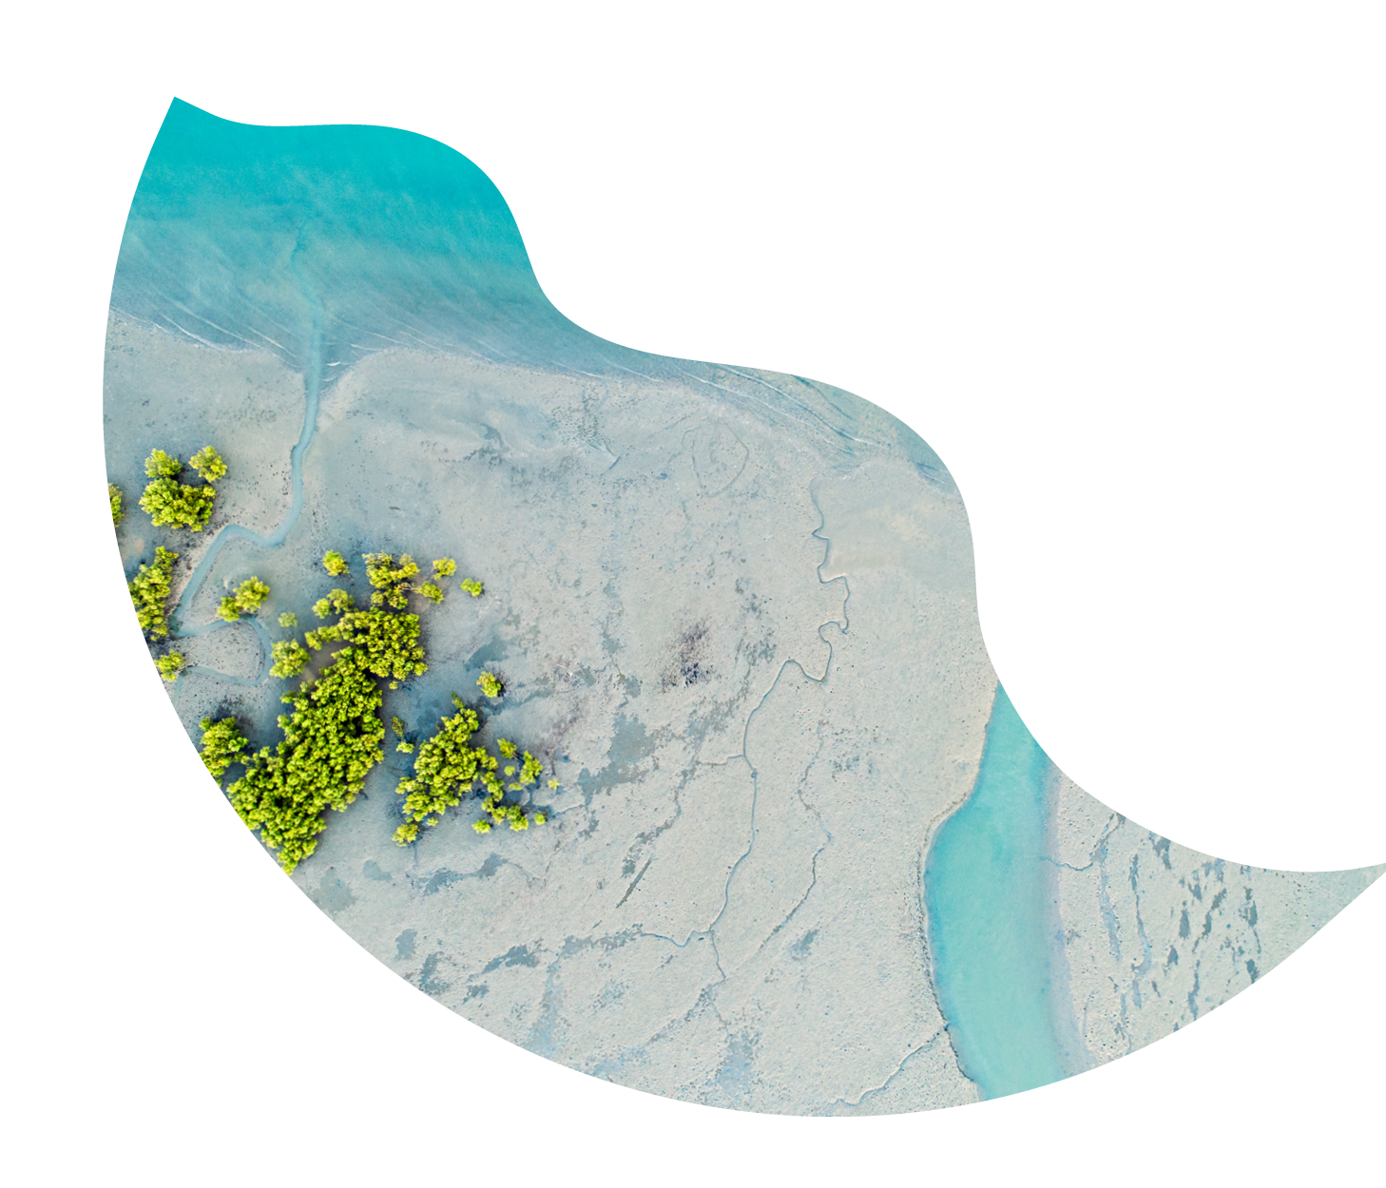
What’s On the Menu?
A buffet of sorts
Notes:
Today I will be discussing the regional report cards, and how we use GIS to enhance and expand their impact
I will introduce my team, the Healthy Waters Partnership, and explore everything from your standard site map, to 3D models, interactive StoryMaps, and automated workflows.

Slide 4
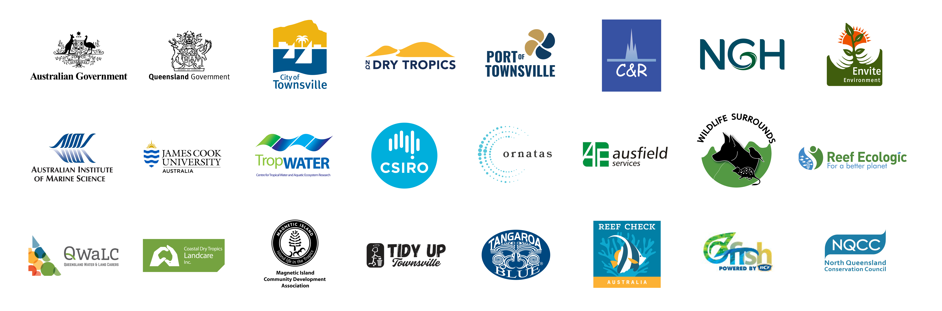
Notes:
The Healthy Waters Partnership for the Dry Tropics is a collaboration of more than 20 organisations from industry, research, business, non-profits and community — all sitting at the same table.
We focus on Townsville and the surrounding region, expanding from Crystal Creek in the North, to the Australian Institute of Marine Science in the South. And all the way from Ridge to Reef.
For the past 5 years we’ve been bringing our local data together to produce one annual Waterways Report Card — providing a holistic all-of-system picture of the health of our waterways.

Slide 5
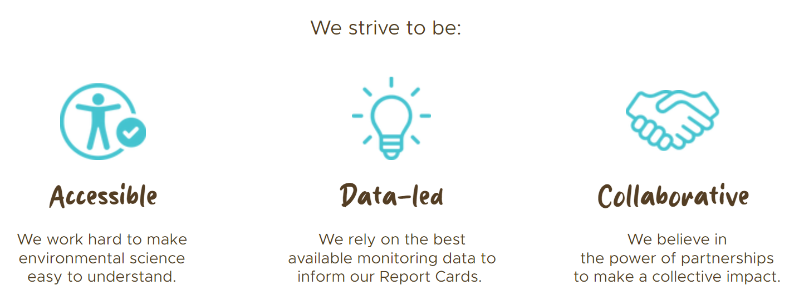
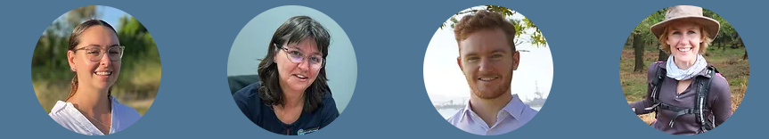
Notes:
The Healthy Waters Partnership strives to be accessible, data-led, and collaborative
We are a team of 4, and are supported by a host organisation, a management committee, a chair, a technical working group, and an independent science panel

Slide 6
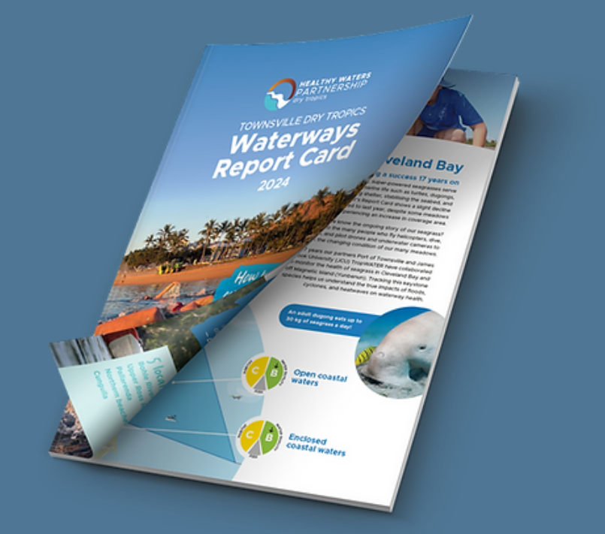

Our Flagship Product
Notes:
Our flagship product is the Waterways Report Card
Each year we gather and evaluate the most reliable environmental data available in our region to present an overview of the most recent condition of our local waterway environments.
This data includes water quality, habitat and hydrology, fish, corals, seagrass, litter, climate, land use, and more.
All of this is written up into a 200+ page technical document, and then further collated into an annual Report Card – our flagship product.
The purpose of this flagship product is to effectively convey complicated and technical scientific information in a format that is easily digestible by the general public.
If you are interested, I have brought some with me

Slide 7
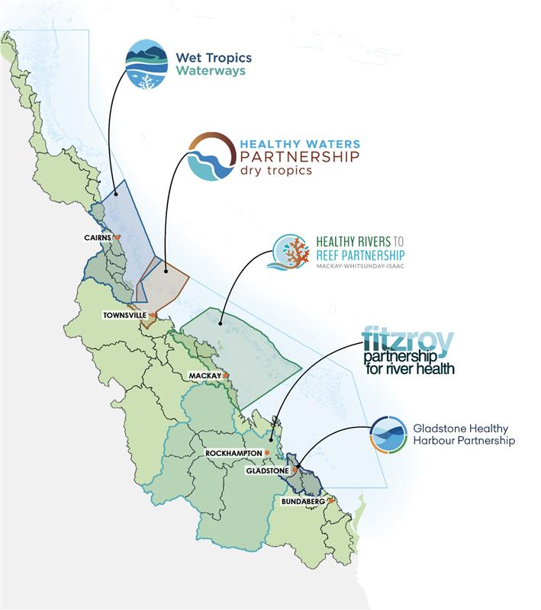
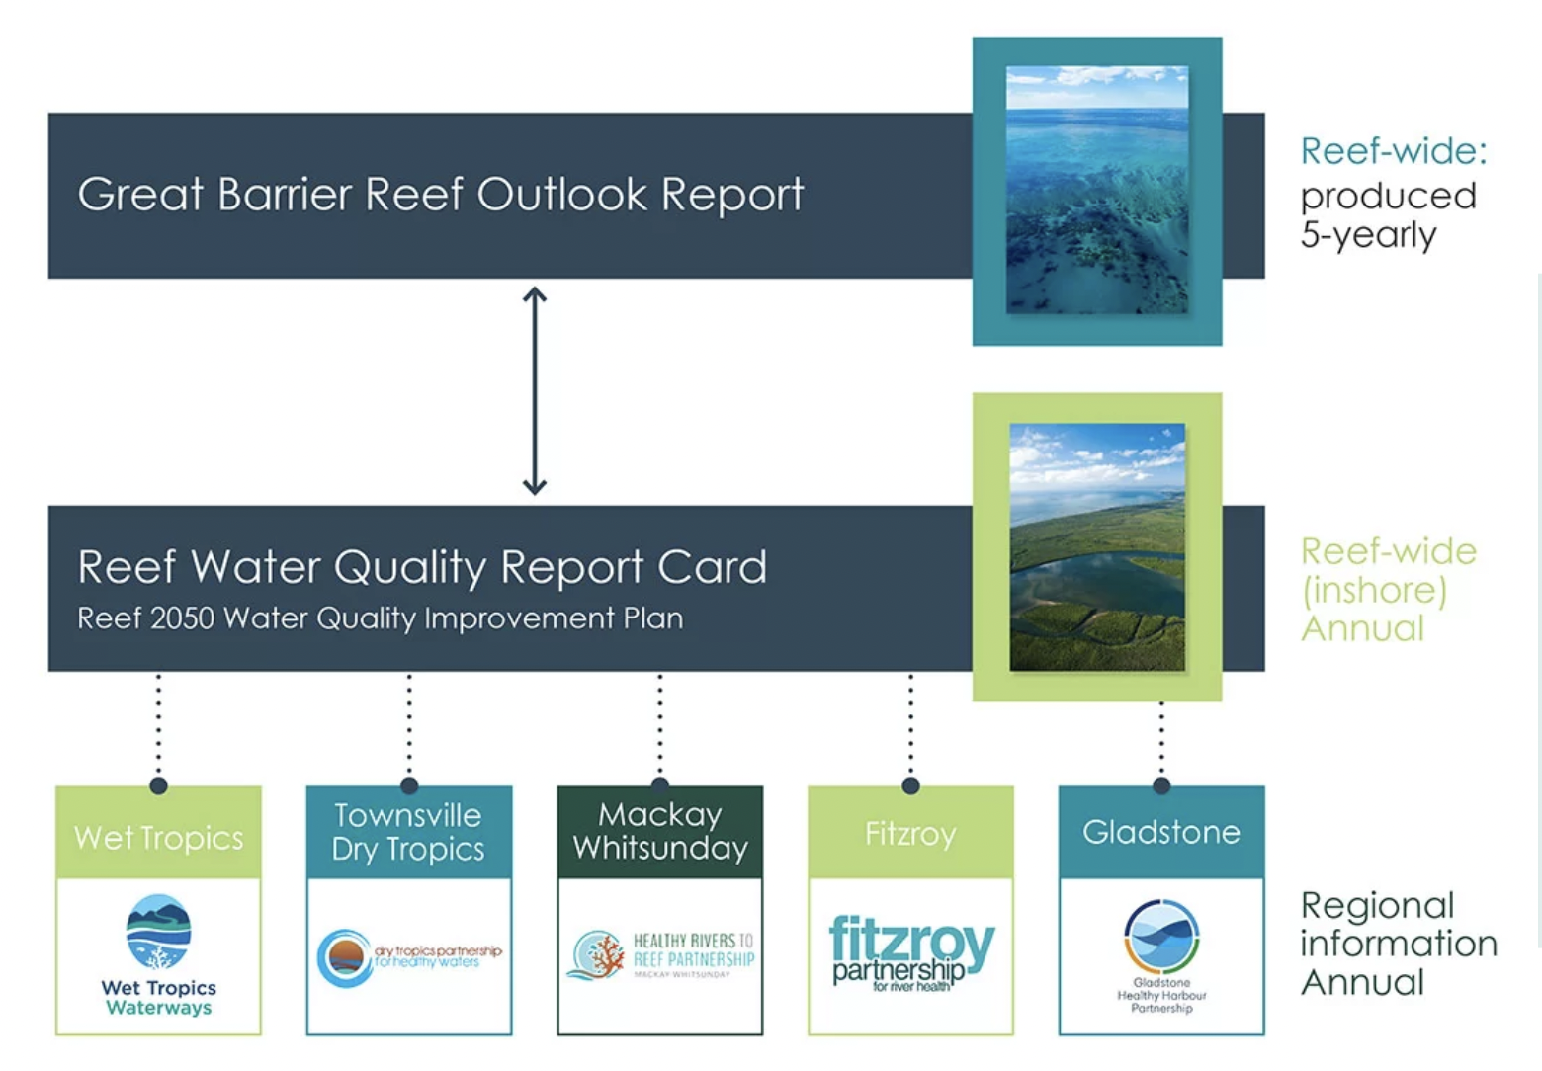
A United Front
Notes:
We are not alone.
Our local Townsville-based Partnership is the youngest of 5 similar partnerships along the length of the Great Barrier Reef.
And our Partnerships are being led and overseen by the best data and environmental thinkers that Queensland and Australia has to offer.
Regionally specific report cards identify waterways of concern at a finer scale, and are nested within larger reef wide reports and decision making tools.
This allows for the Partnership to advocate for management efforts and outcomes that support healthy rivers and healthy reefs within our region.

Slide 8
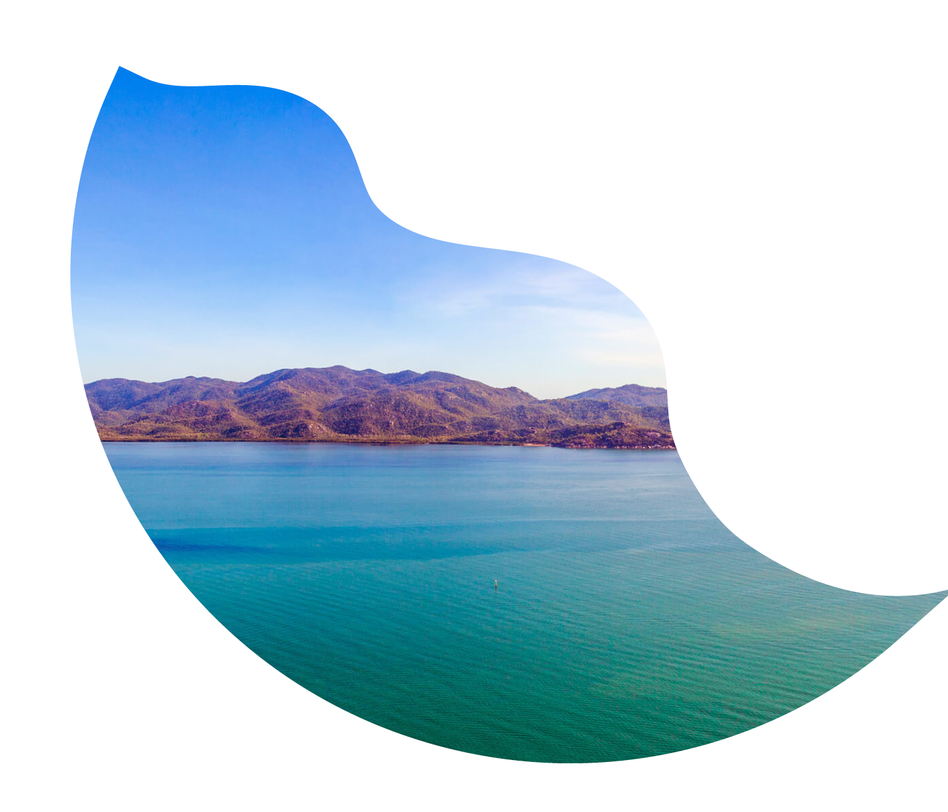
Adam Shand (Who’s this guy?)
Notes:
Now I think it is about time I introduce myself properly.

Slide 9
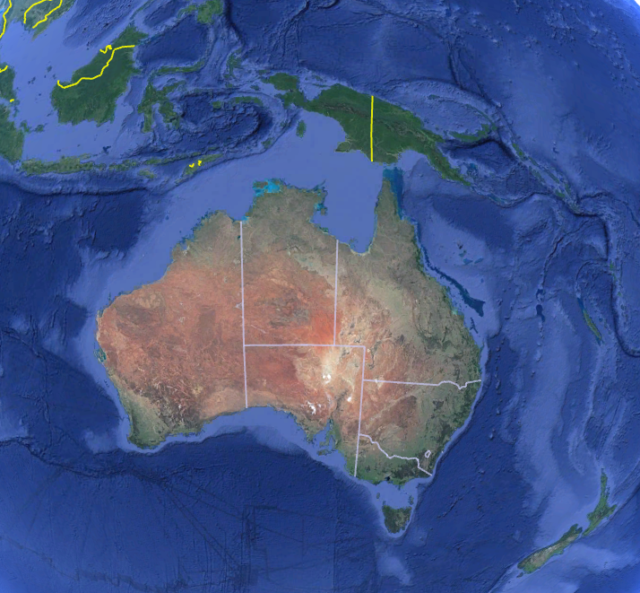

A Bad Extrapolation
???
Philippine Sea
Townsville
Gold Coast
Coffs Harbour
New Zealand
Notes:
In the spirit of this GIS conference, I thought I’d use a map for this part
So, when I was young my parents move to Australia from New Zealand
[CLICK]
I grew up in Coffs Harbour, NSW
[CLICK]
Before moving to the Gold Coast to complete a marine science degree, and a science degree with honours
[CLICK]
A couple of years ago I Moved up to Townsville to start my role as an environmental data analyst
[CLICK]
By looking at this path, I can confidently say that I expect to be working somewhere in the Philippine Sea by 2026

Slide 10
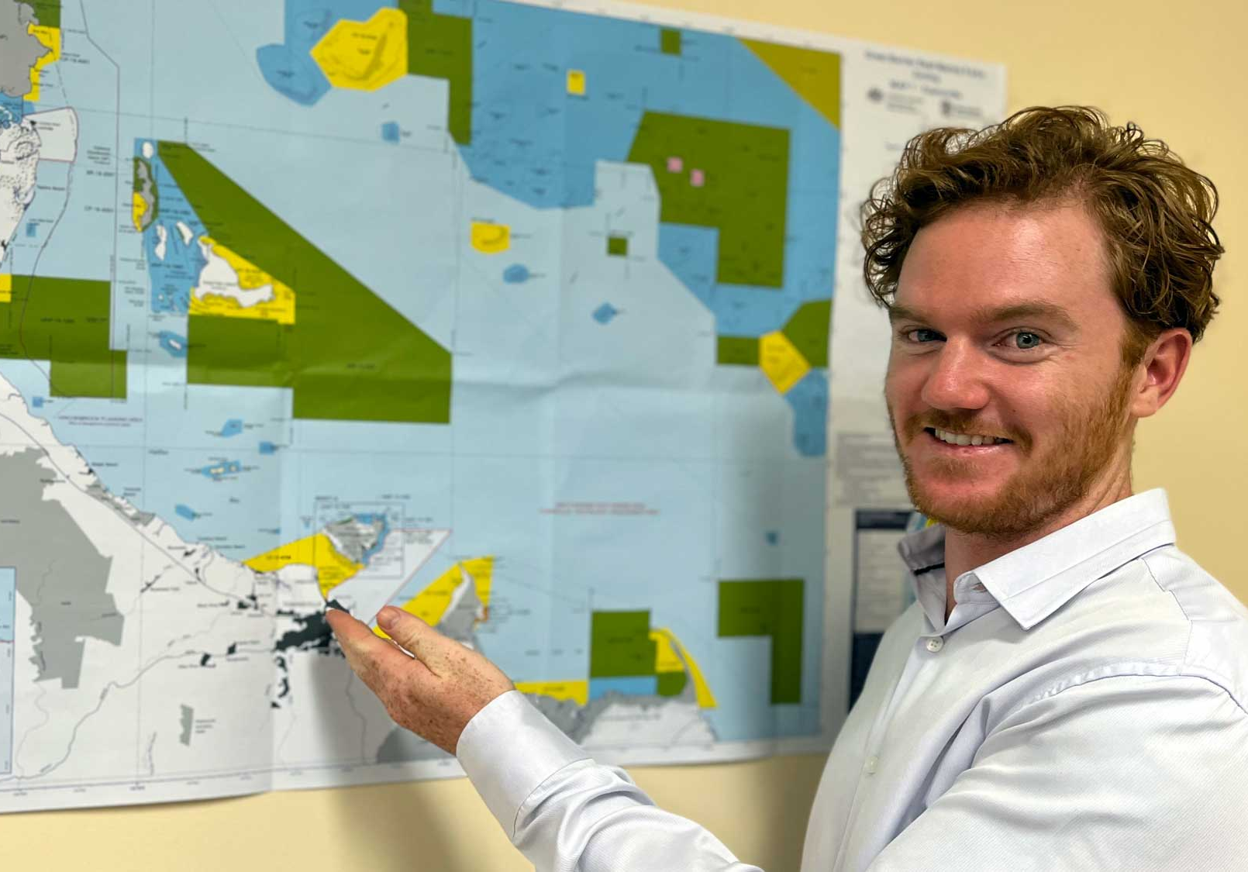
My role in the HWP team
Environmental Data Analyst
Data Analysis
Technical Documents
Opportunity Exploration
“Good at R”
– my mum, circa 2024
Notes:
Within the Healthy Waters Partnership, I have the role of Environmental Data Analyst
I spend most of my days analysing data – shocker
And writing the technical documents for the partnership
As well as doing what I like to call “opportunity exploration” – which is basically me creating extra work for myself in the name of science
Most of my work is completed in the programming language “R”
[CLICK]
And I come with some stellar recommendations about my skill
Those with a key eye may also notice I look a little different than the picture. That story is definitely not presentation worthy.

Slide 11
My role in the RRCN
“That GIS guy”
– HR2RP team, circa 2023
Notes:
As I noted earlier, the Healthy Waters Partnership is one of 5 report card organisations
We try our best to collaborate and share workloads between each of the teams.
Our goal is to unify and streamline our methods, such that we are not a) repeating the same task, or b) presenting work that may “appear” the same, but was done differently under the hood.
To this end, each team member brings something unique to the table and we share our skills between groups.
Unfortunately, a lot of the other organisations also had someone with skills using R.
Although no one had much GIS knowledge.
So about a year ago I decided to try and fix that gap, and have since taken it upon myself to learn GIS.
And I would like to linger on that point for a moment because it has become clear to me over the course of these two days that I am surrounded by those with knowledge that far exceeds my own.
However my recent foray into the world of GIS is still an excellent segue to the core of this presentation

Slide 12
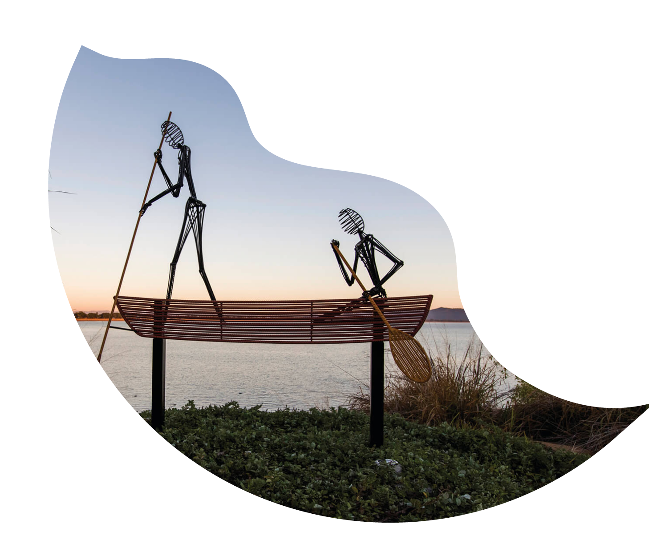
The Power of GIS (The juicy part)
Notes:
The power of GIS
So now I’ll talk about two main things
1. GIS related things that we currently do in the Technical report and our flagship product – the report card.
And 2. Other spatial adventures that I have been up to

Slide 13
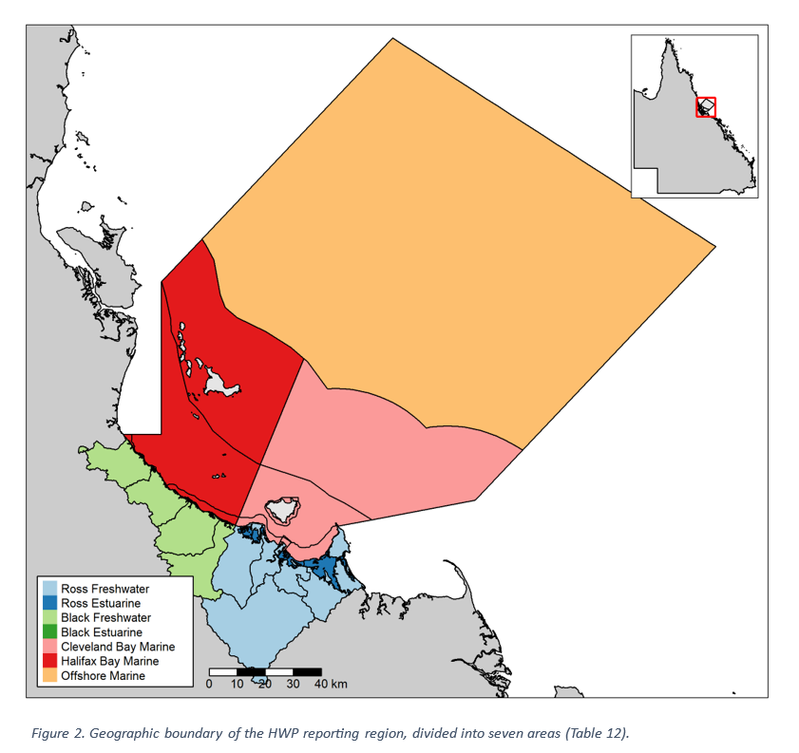
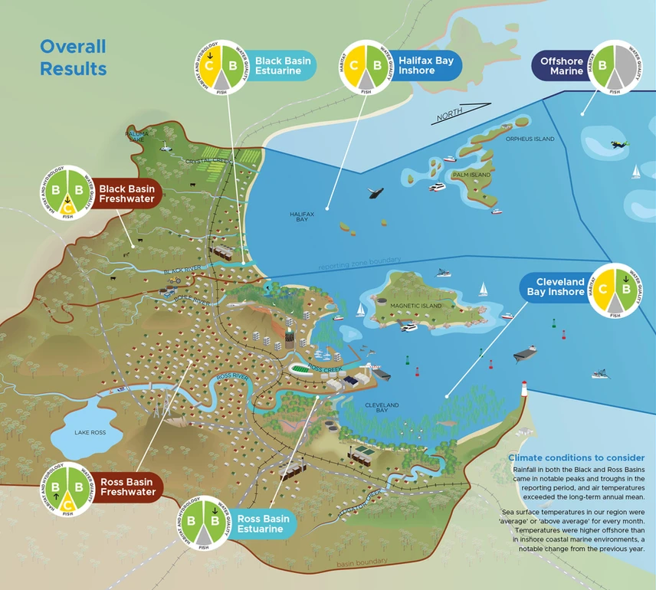
The HWP Reporting Region
Notes:
Throughout our technical report there are a range of areas in which we use GIS to communicate complex information
As a first example, we have the classic reporting region map.
In this map we show the entire Healthy Waters Partnerships’ reporting region.
Our region is broken into 7 key areas, each designated with its own colour.
We have two freshwater areas, two estuarine areas, two inshore marine areas, and one offshore marine area.
[CLICK]
A stylised version of this map is used in our Report Card.
On screen is the complete overview, however we also create full page maps for each of the seven key areas that we report on.
Although incredibly basic, these maps always serve as a remind to me that a picture really is worth a 1000 words.

Slide 14
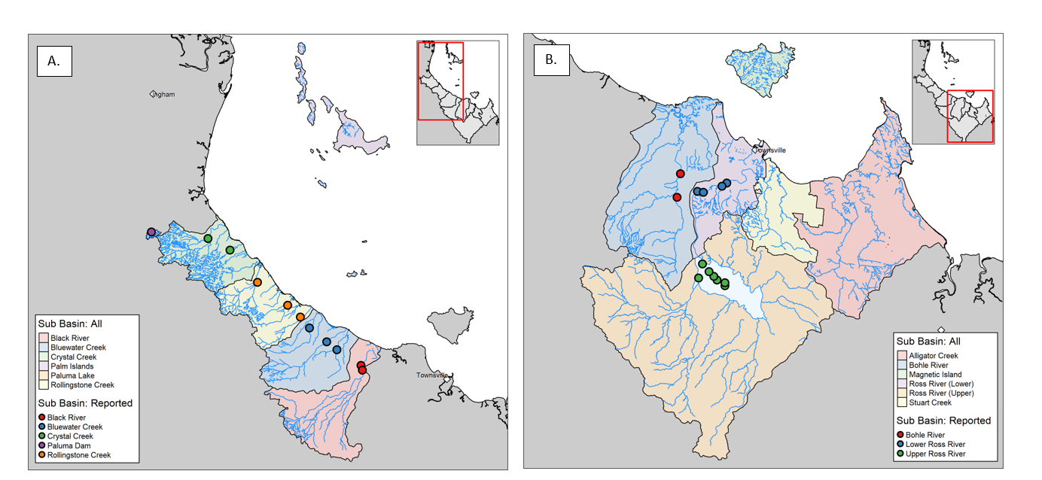
A Classic
Notes:
Another classic that we have in our technical report is the site map.
The maps on screen show water quality sample sites in the freshwater basins of our reporting region.
As I mentioned earlier, the Healthy Waters Partnership collects data from a wide range of partners,
More than 27,000 data points per year by the way.
And of course, because the data is shared by multiple different organisations, it comes in a wide range of formats, styles, and with varying degrees of quality control.
Therefore, we find that a site map is an essential tool when collating all the data.
To emphasize the importance of these maps, it wasn’t until we created them that we realised what a large area in the Ross Basin we had that did not contain any water sampling locations.
And it is because of these maps that we are working with our partners to establish long term monitoring programs in the region to address this short coming.

Slide 15
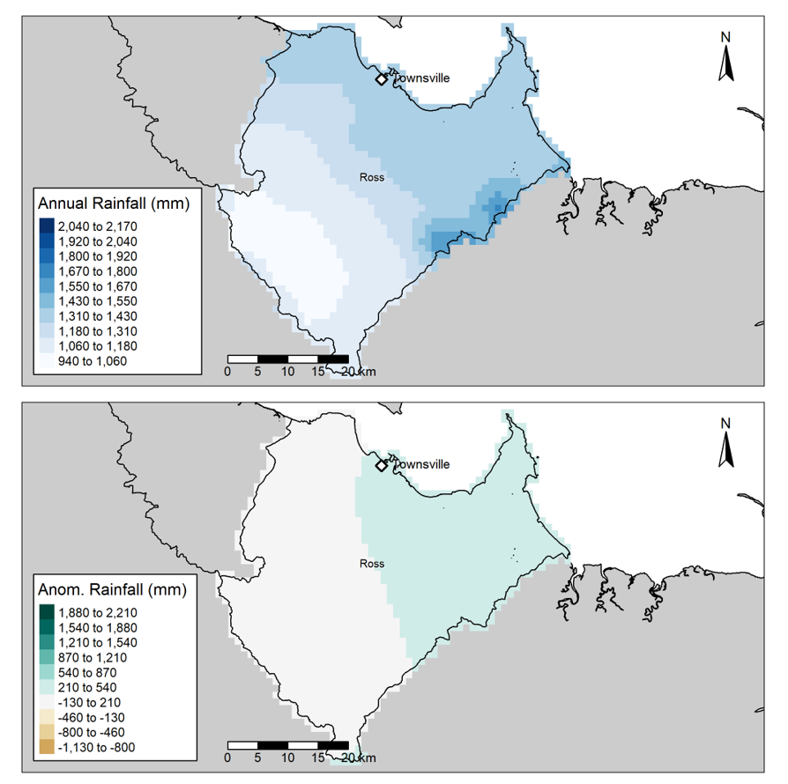
Climate & Land Use
Rainfall
Air Temperature
Sea Surface Temperature
Degree Heating Weeks
Land Use
Notes:
Of course, in the technical report we do more than just reporting region maps, and sites maps.
Other aspects of our technical report include a detailed climate analysis where we look at rainfall, air temperature, sea surface temperature, degree heating weeks, and land use.
For example, in this map we are comparing the annual rainfall in the Ross Basin, to the long-term mean rainfall we have historically seen in the Ross Basin
Each of these variables play a critical role in understanding the state of the environment for the year.
Was there a cyclone? A flood? Several heatwaves?
Or what about more subtle variations? Perhaps there was an unusual amount of rain on our coastlines, but much less on our ranges.
It is important to understand each of these variables for when we write our technical reports as it may have an impact on the water quality in our rivers, the vegetation we find on our banks, and the fish we find in our waters.

Slide 16
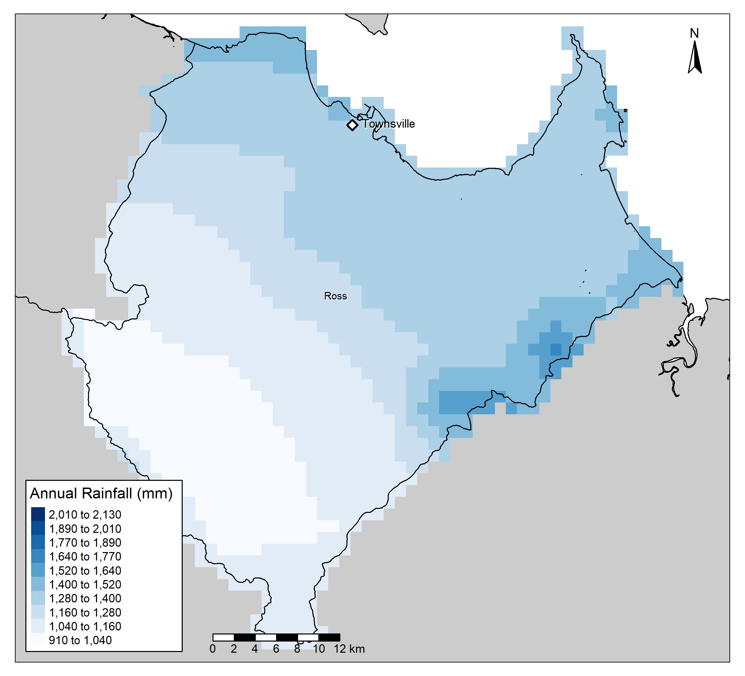
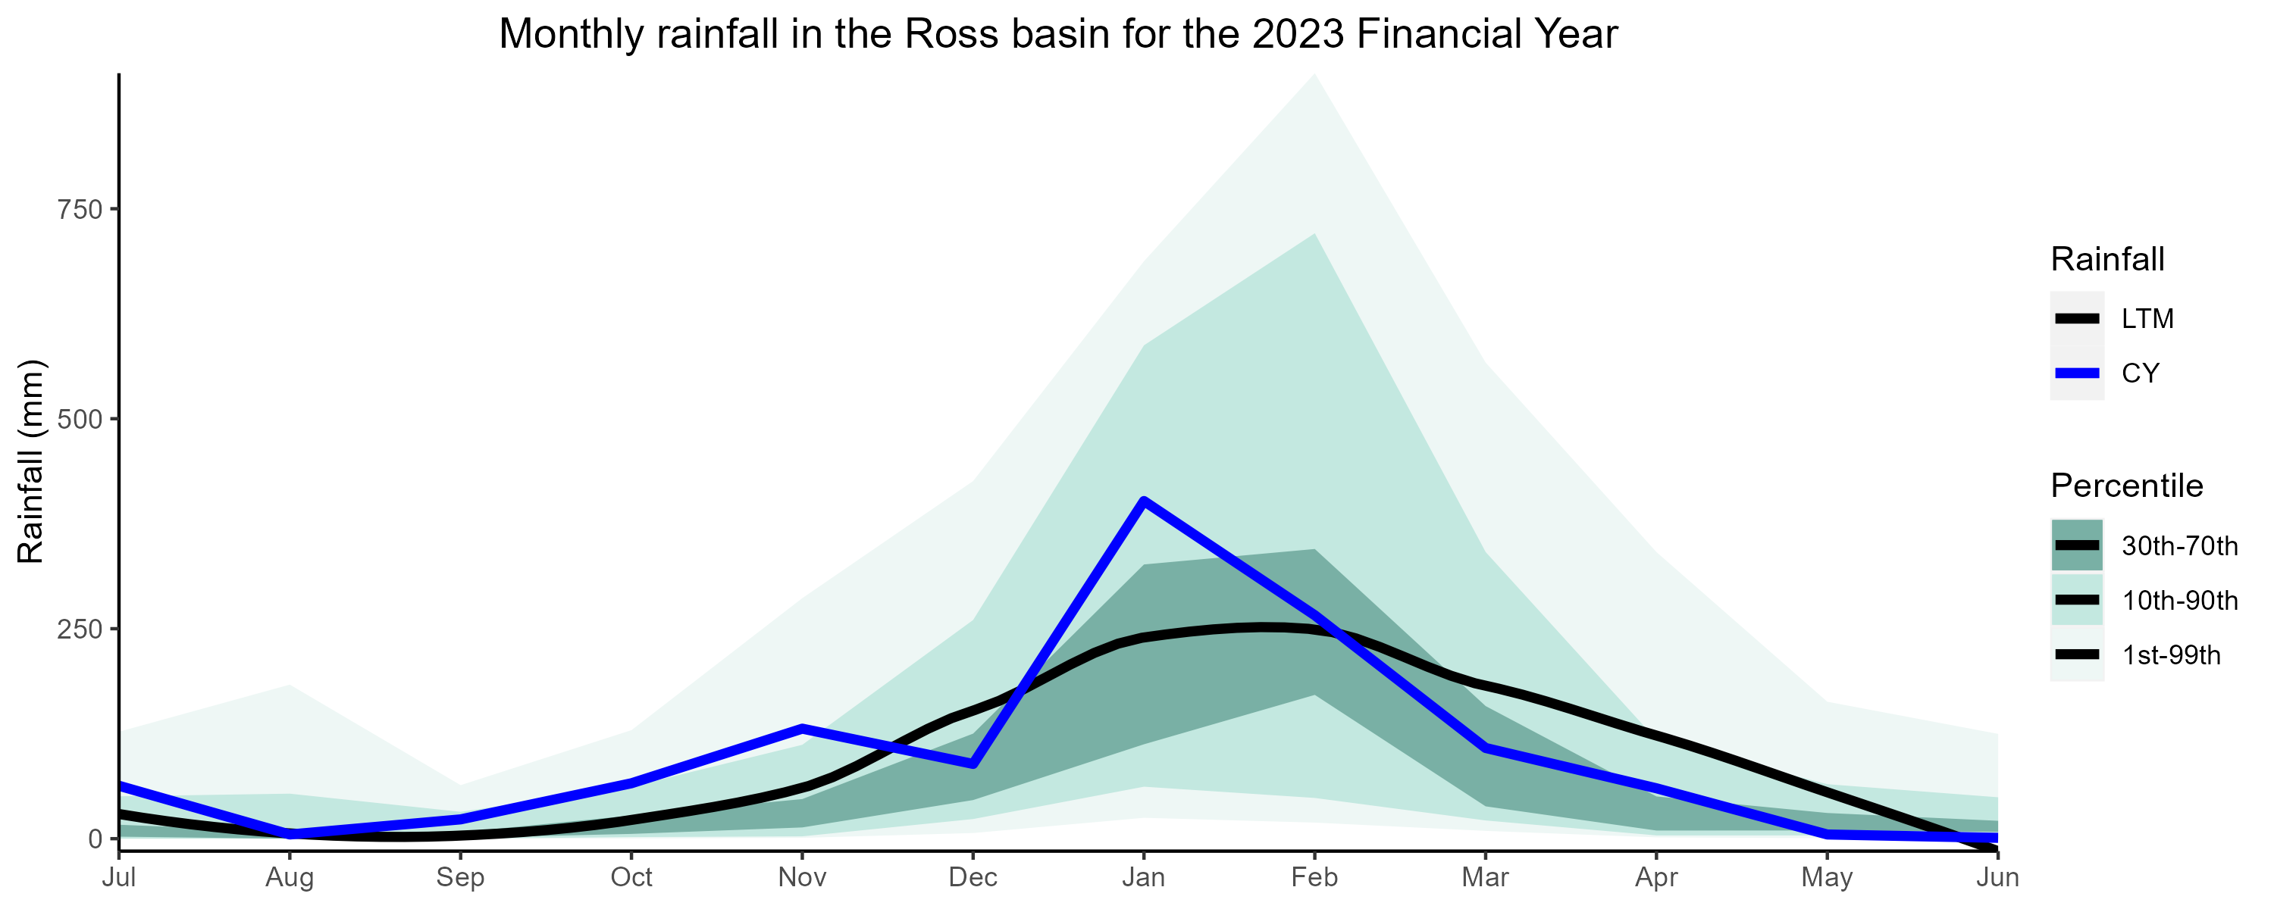
Rainfall Refined
Region | Basin | Jul | Aug | Sep | Oct | Nov | Dec | Jan | Feb | Mar | Apr | May | Jun | Annual
Dry Tropics | Ross
<= Lowest 1% | < = Very much below average | <= Below Average | <= Average | <= Above Average | <= Very much above average | <= Highest 1%
Notes:
And we don’t stop there.
We also use GIS to determine the monthly rainfall we experienced in each of our key areas.
And we look at this monthly rainfall compared to the long-term average rainfall for that month.
For example in the graph you can see:
The blue line which represents the rainfall experienced for the current year.
The black line which represents the long-term rainfall
And the shaded sections behind which are different percentile bands.
In the table above you can see for each month, which percentile band they were within.
This is a great example actually, because if we look at the top right of the table we can see that the annual rainfall was average.
However, on a month by month basin it is clear that we had some months with higher rainfall that expected, and others with lower than expected.
So thanks to GIS, now when it comes time to analyse and write about other parts of the technical report we know where and when there was periods of high or low rainfall. As well as if these periods were significantly different to usual.

Slide 17
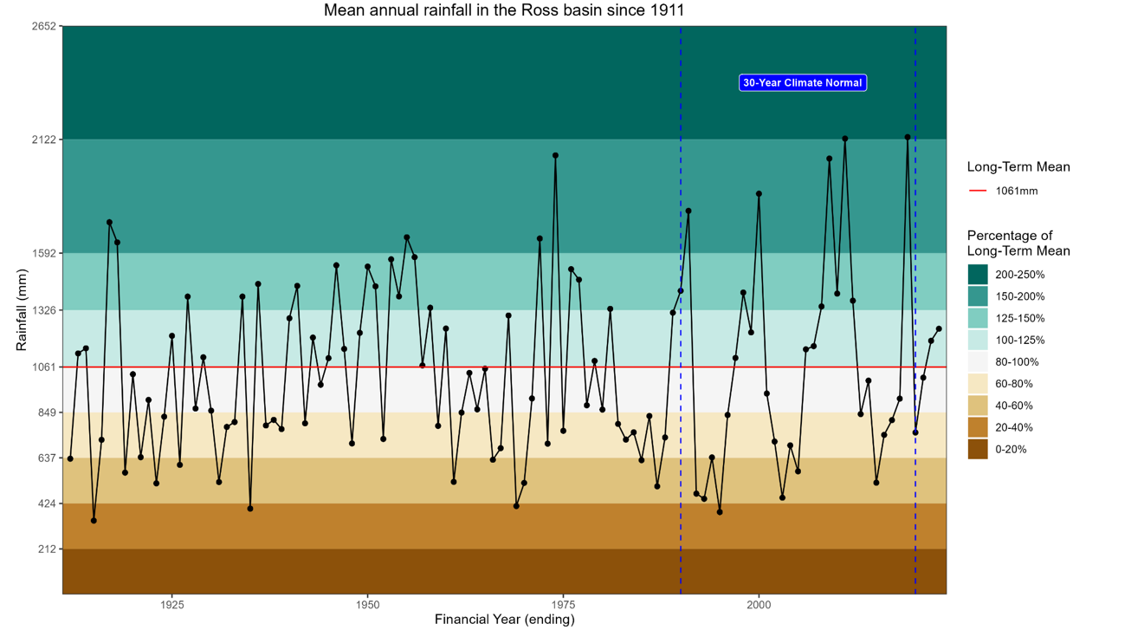
Rainfall Extended
Notes:
And we also go in the other direction, looking at over 100 years of data to achieve a holistic understanding.
In this graph I have also highlighted the 30-year climate normal that we use. That is all of the data between the blue lines.
Earlier when I made comments about the rainfall being higher or lower “than normal” this is the data that we are comparing against.
Some of you may be wondering why we don’t compare our current year against all of the data that we have available, but that is a side tangent suited for a different presentation.

Slide 18
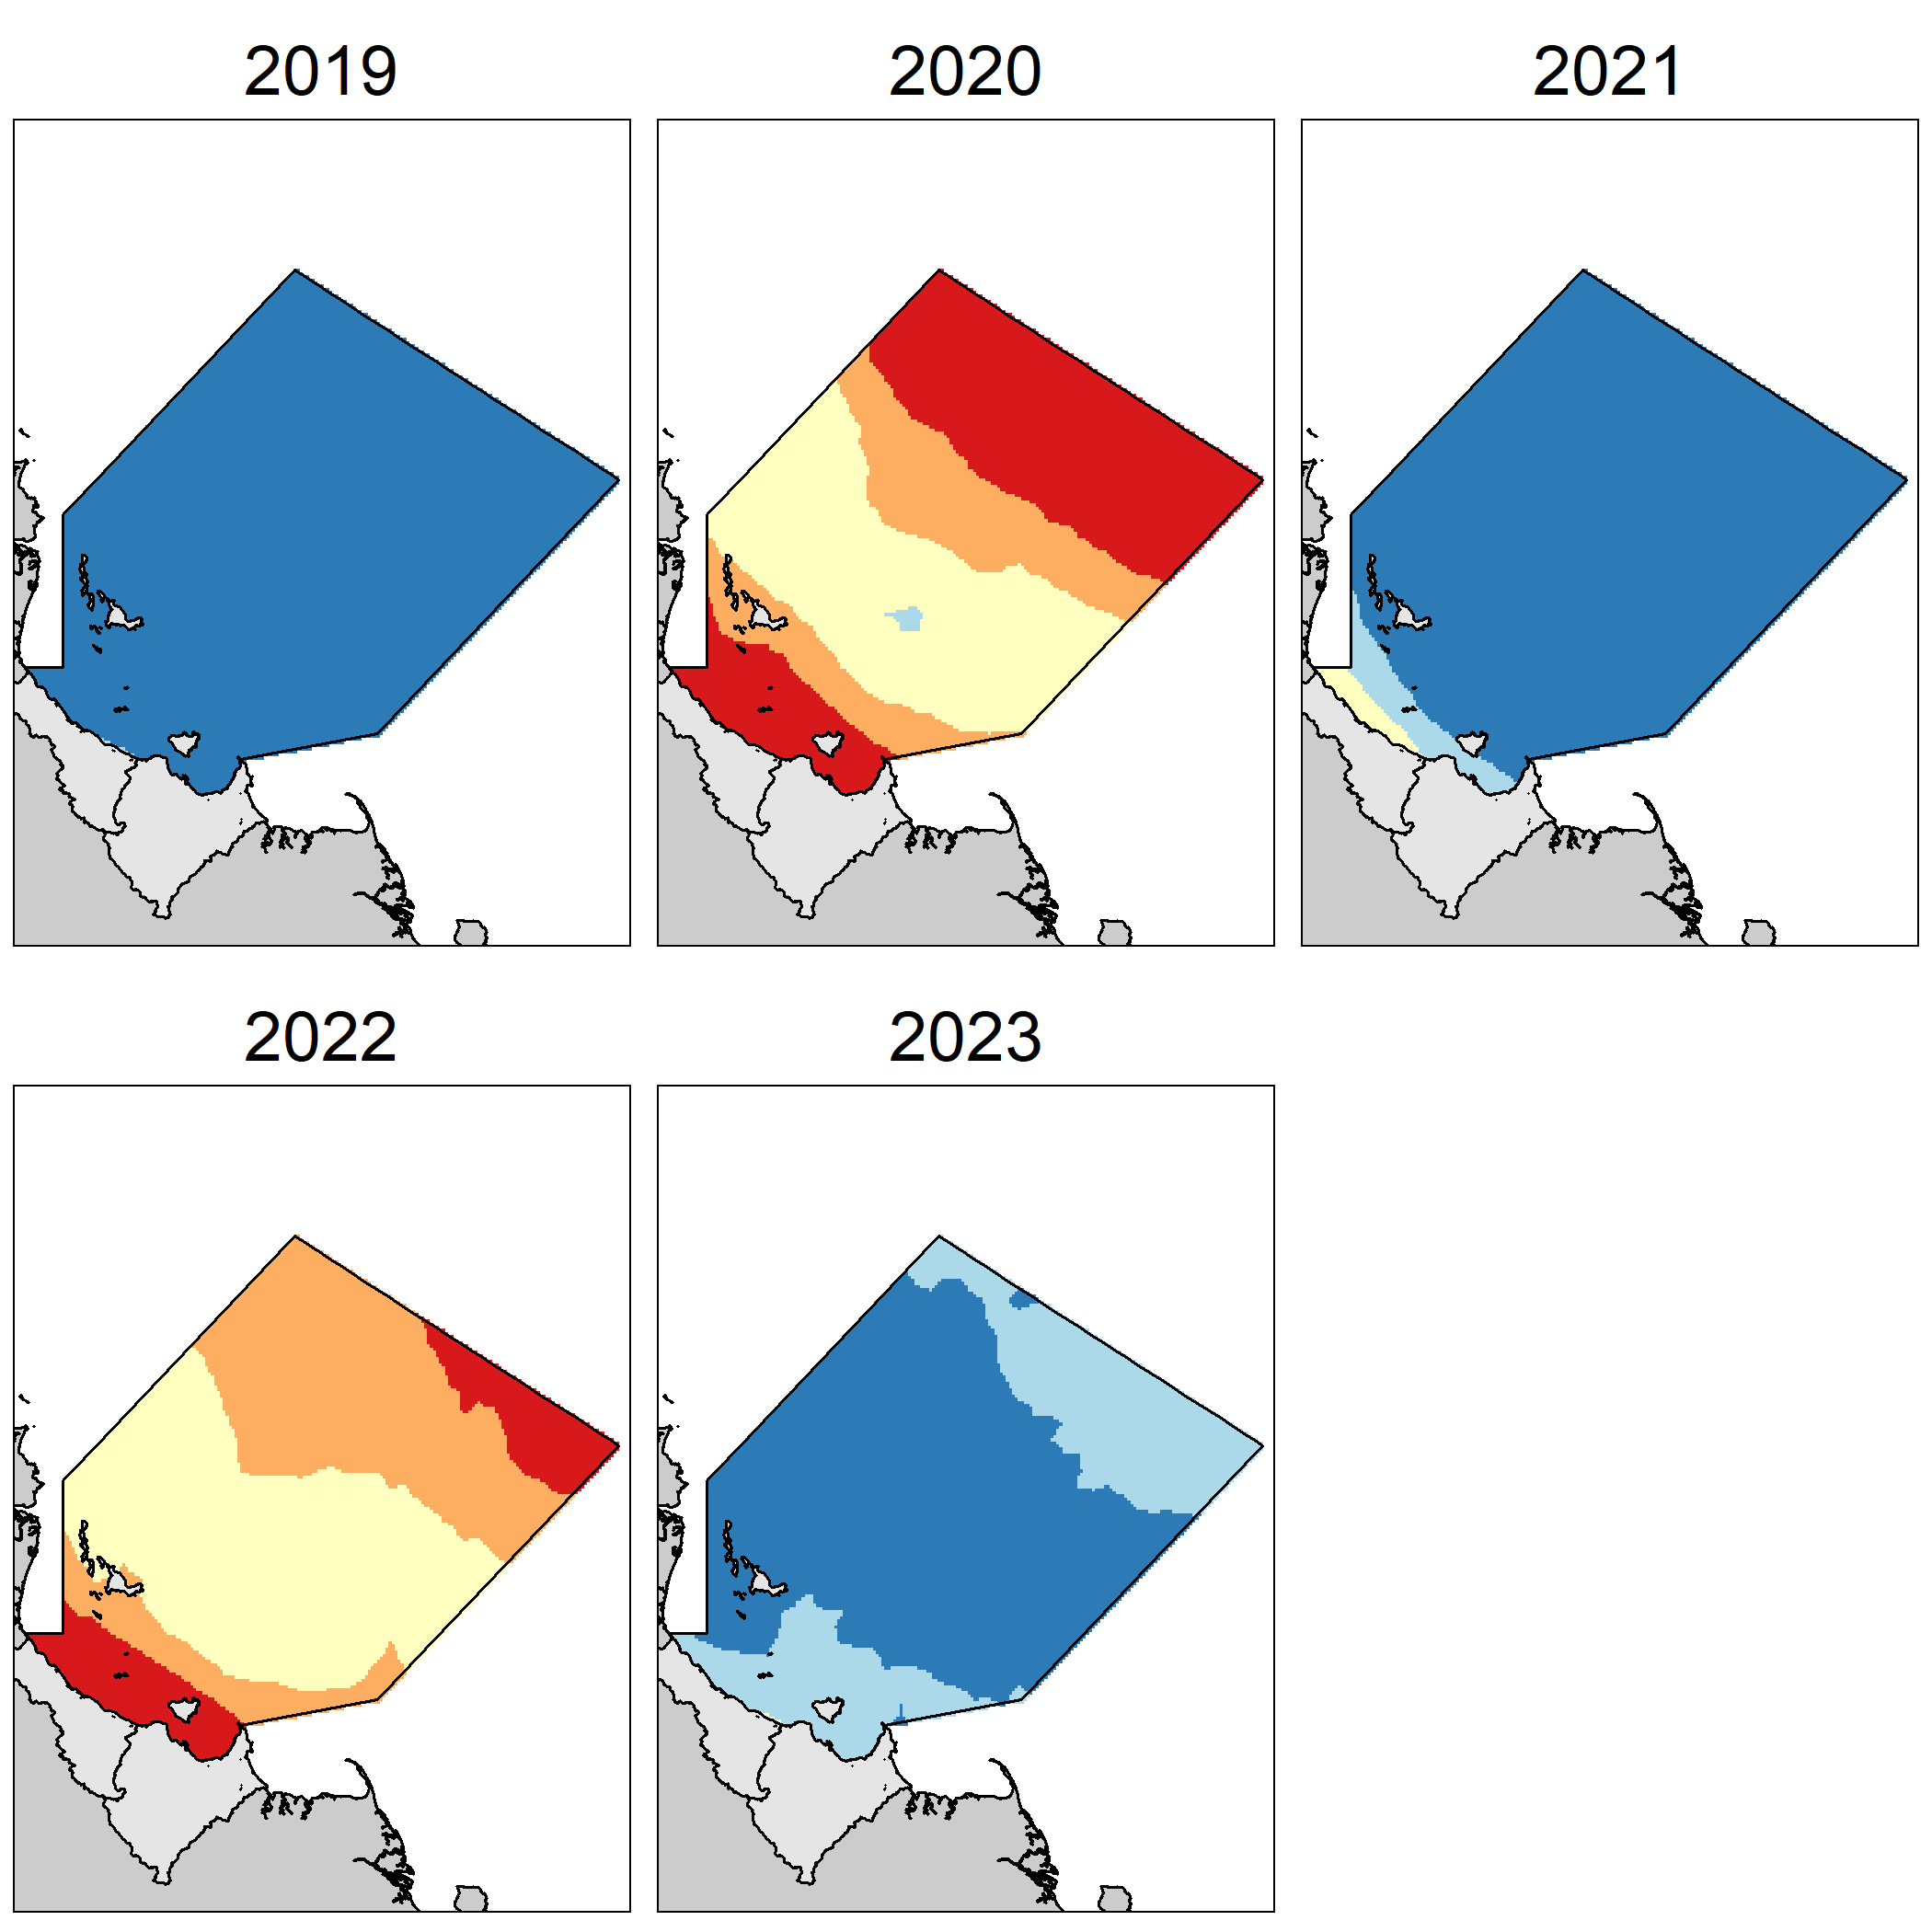
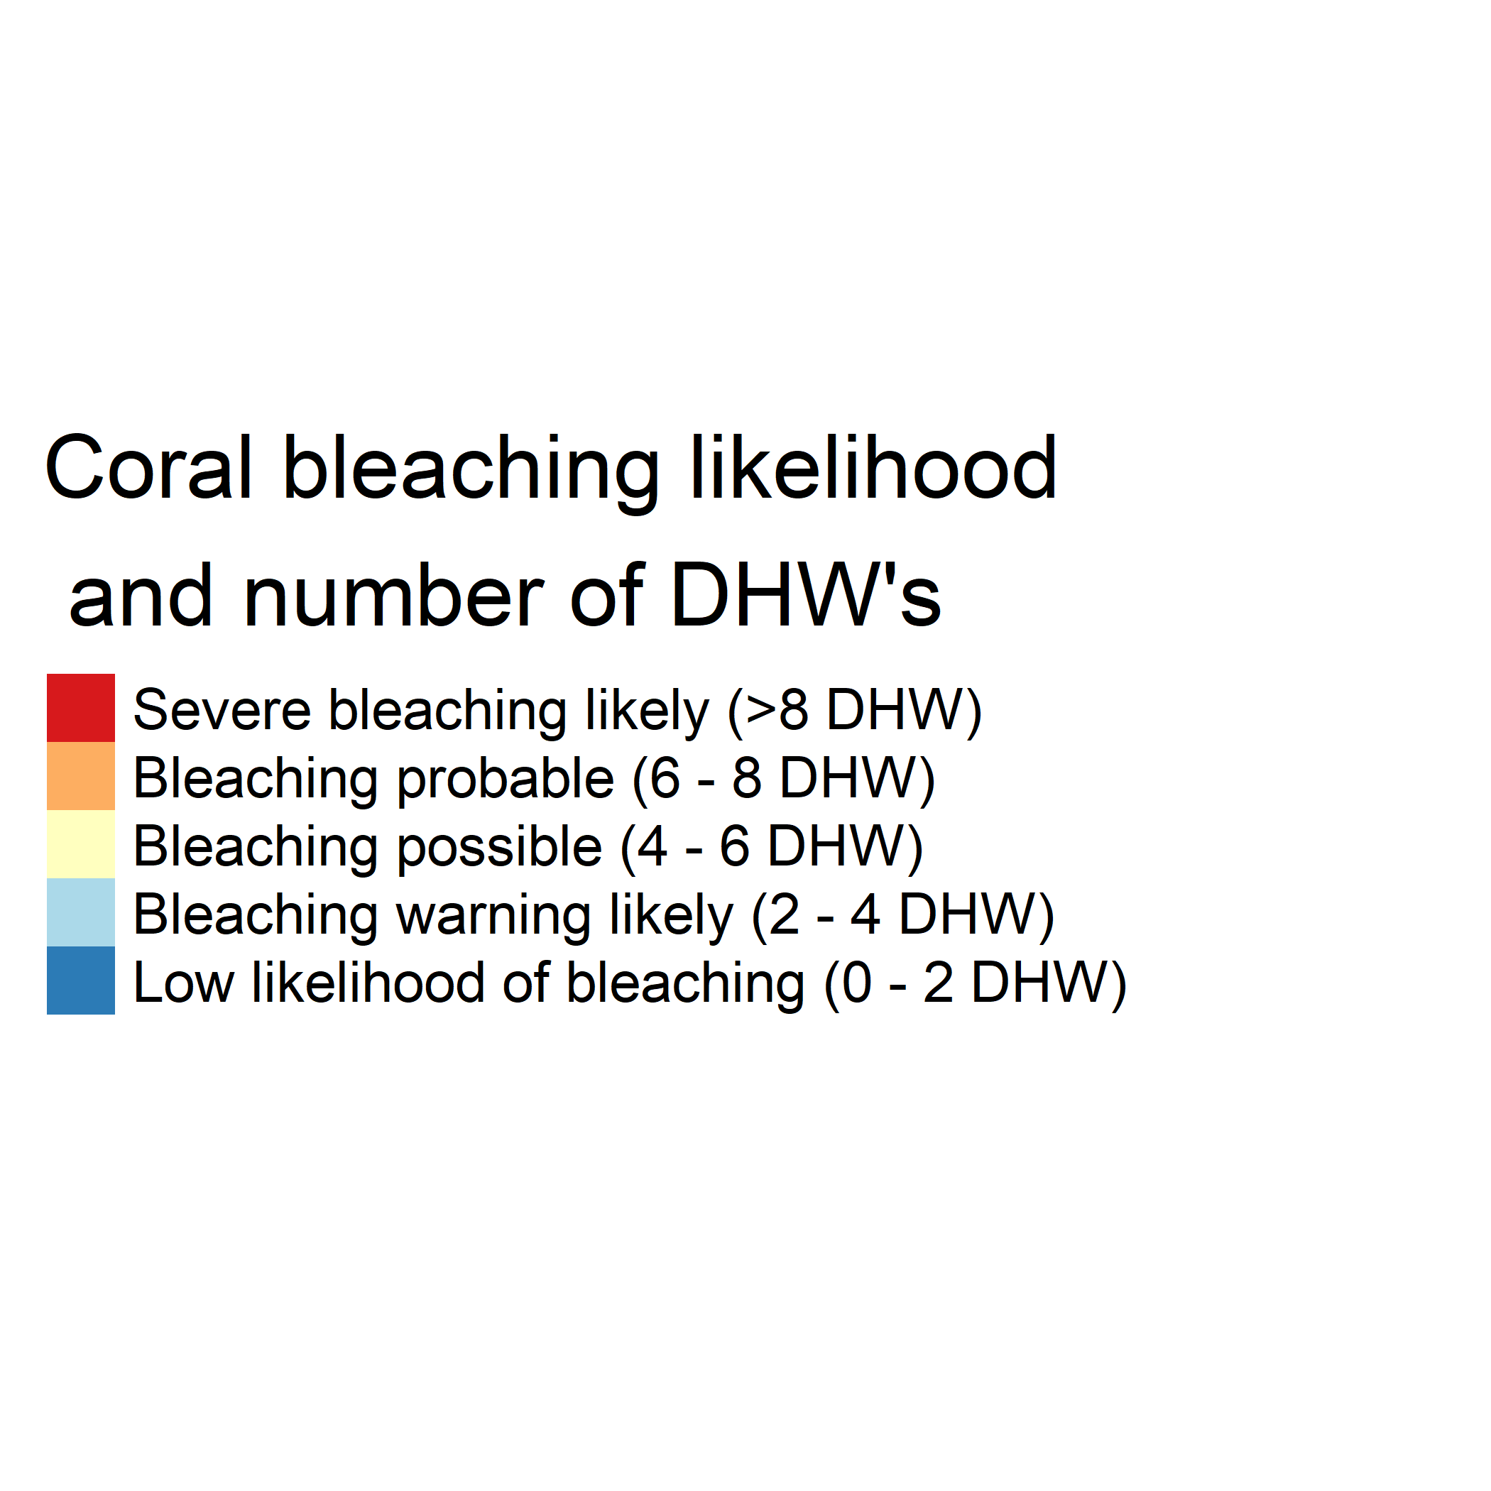
Another One,
Notes:
And remember, in the Healthy Waters Partnership, it’s not just for rainfall, we use GIS as much as we can.
Here we have a map of Degree Heating Weeks in our region.
We use this as a proxy for coral bleaching, and it can help us contextualise the coral health data that we received from our partners.

Slide 19
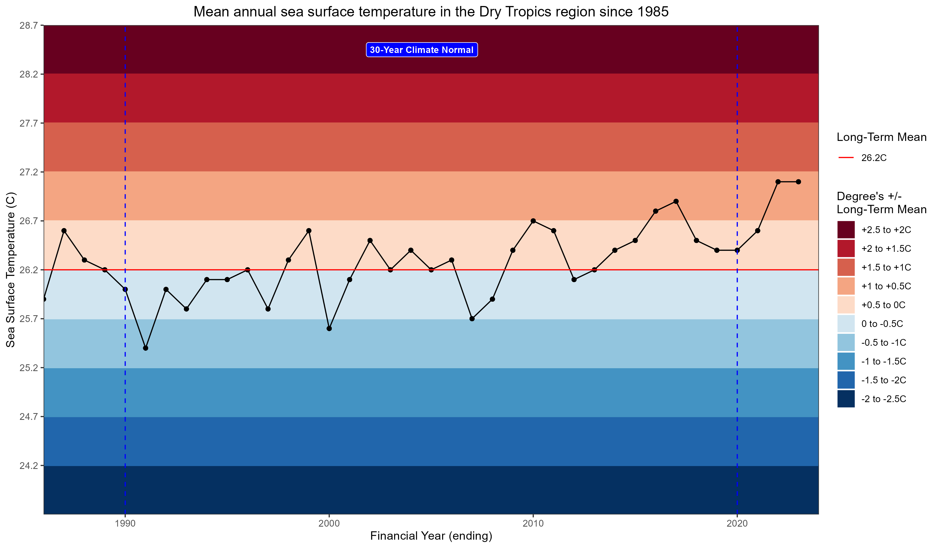
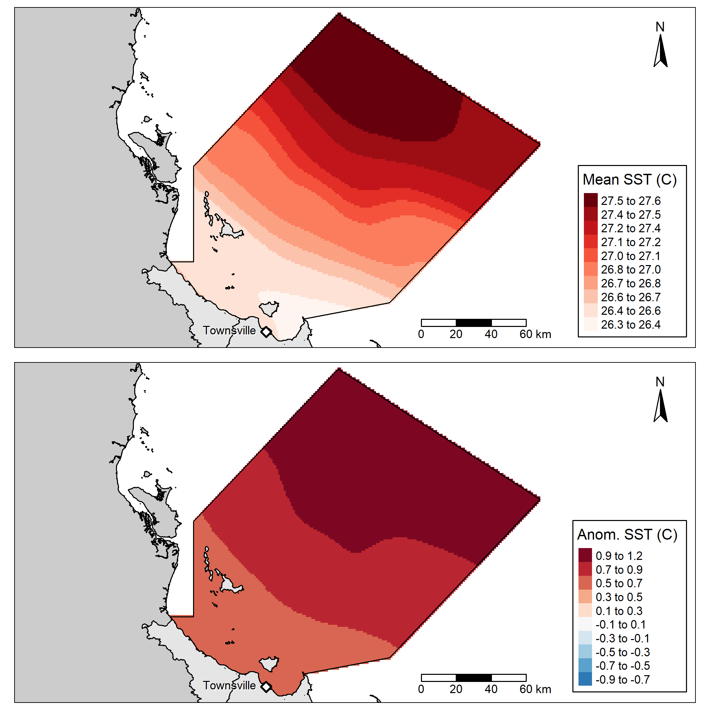
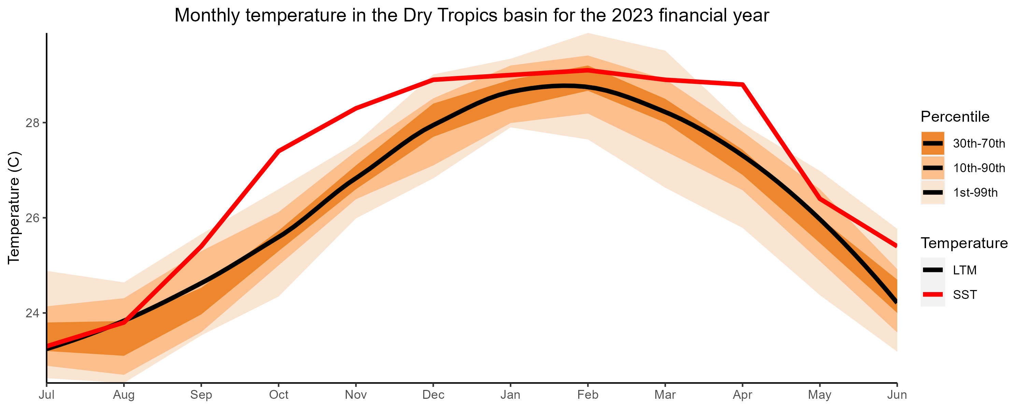
Another One,
Region | Jul | Aug | Sep | Oct | Nov | Dec | Jan | Feb | Mar | Apr | May | Jun | Annual
Dry Tropics | 4 | 4 | 6 | 7 | 7 | 6 | 5 | 4 | 5 | 7 | 5 | 6 | 6
Notes:
And of course, since a major driver of coral bleaching is sea surface temperatures, we look at that as well.
However, this data also has the added benefit of providing exactly temperatures – which are a great tool for communicating with the public.
It allows people to envision climate impacts offshore where they may not visit in their everyday lives, and it can connect their experiences with what is really happening out there.
Sea surface temperatures also provide contextual information for our marine water quality data such as chlorophyll a.

Slide 20
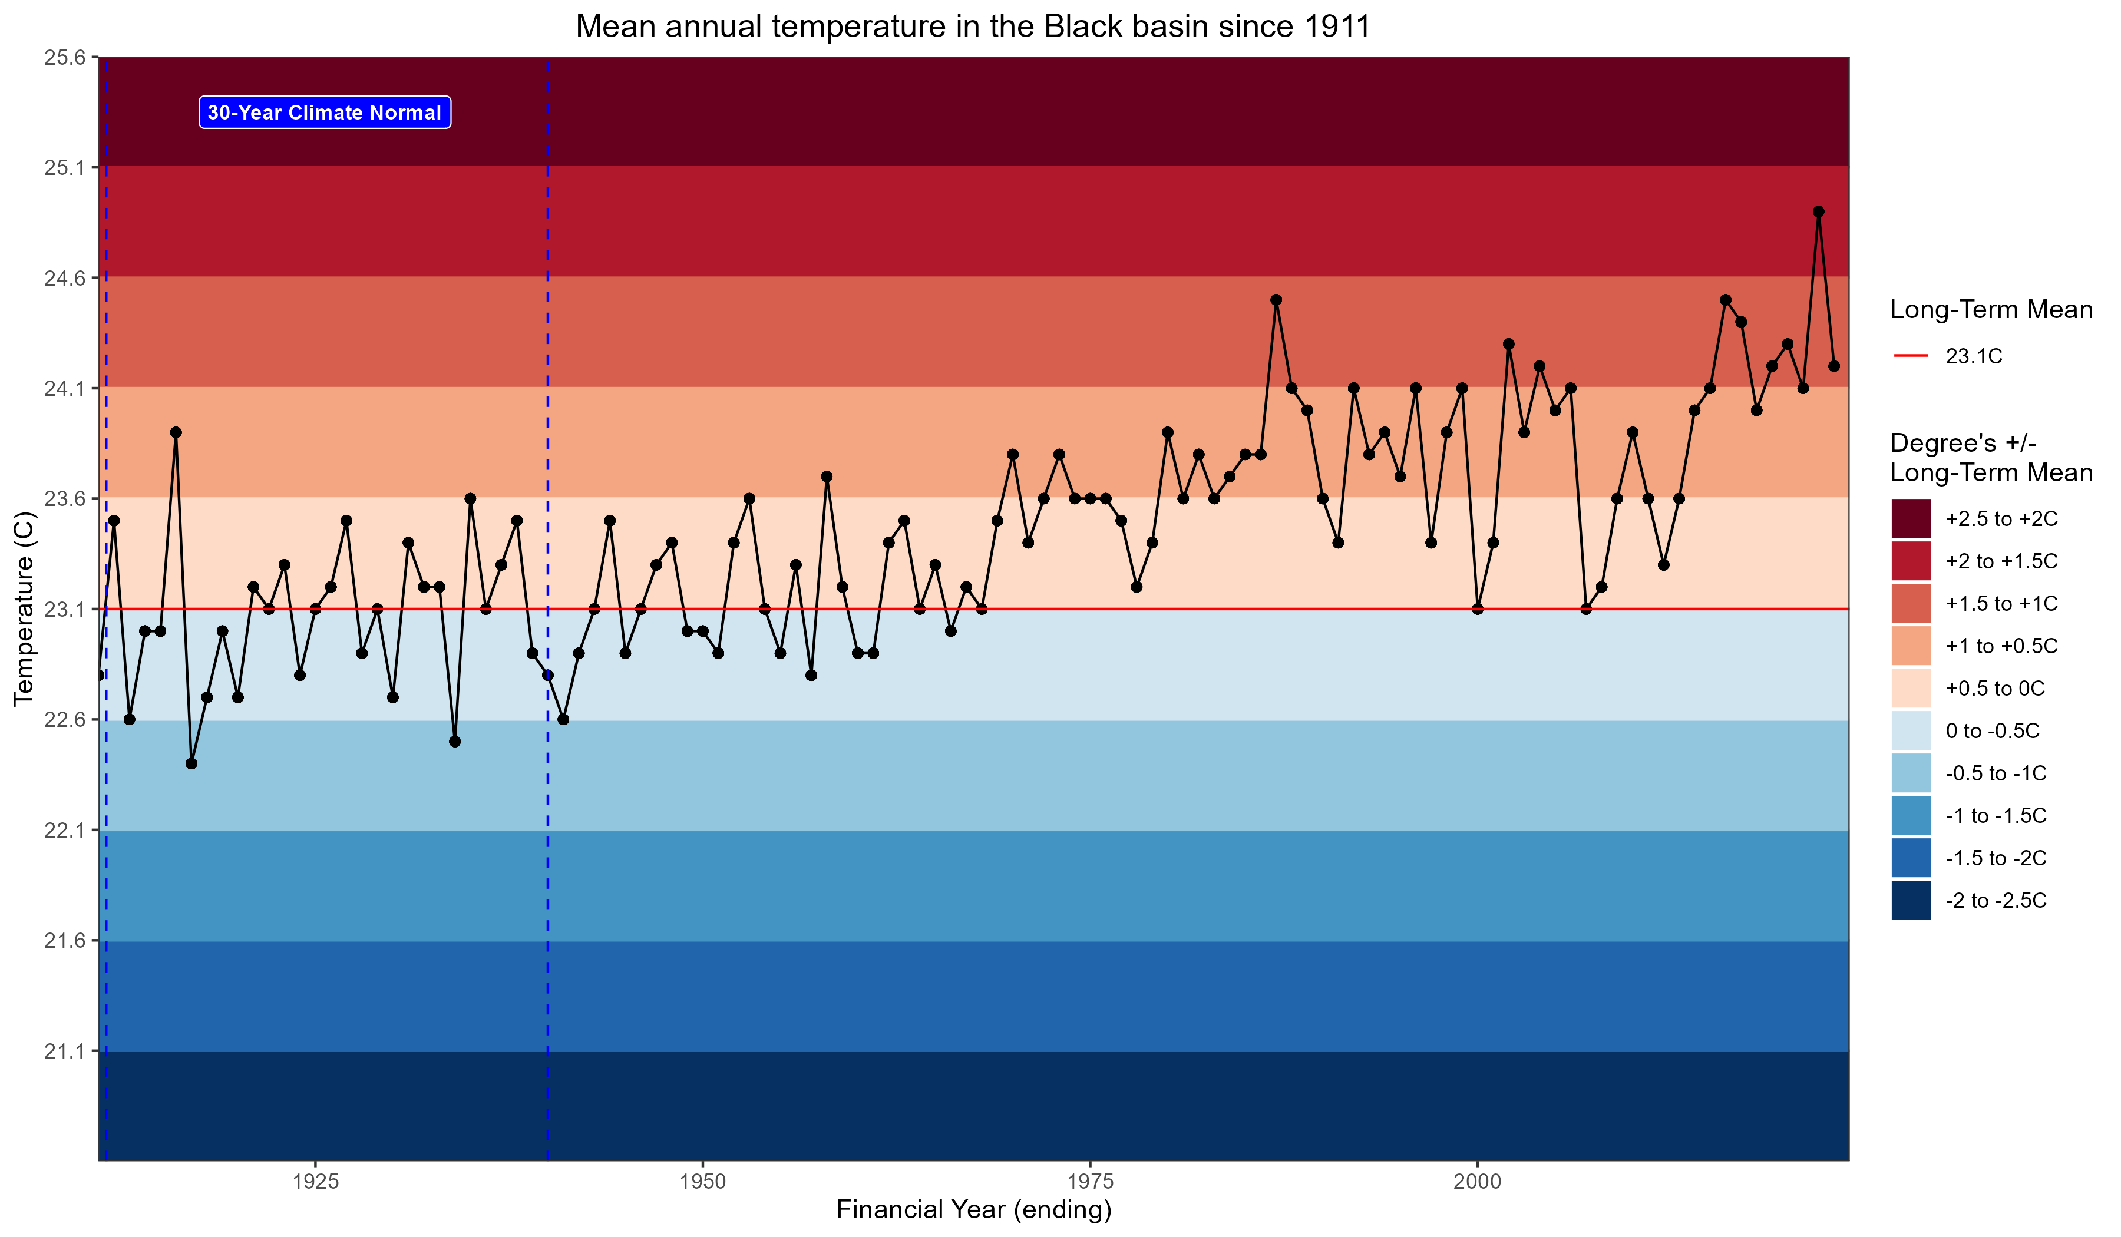
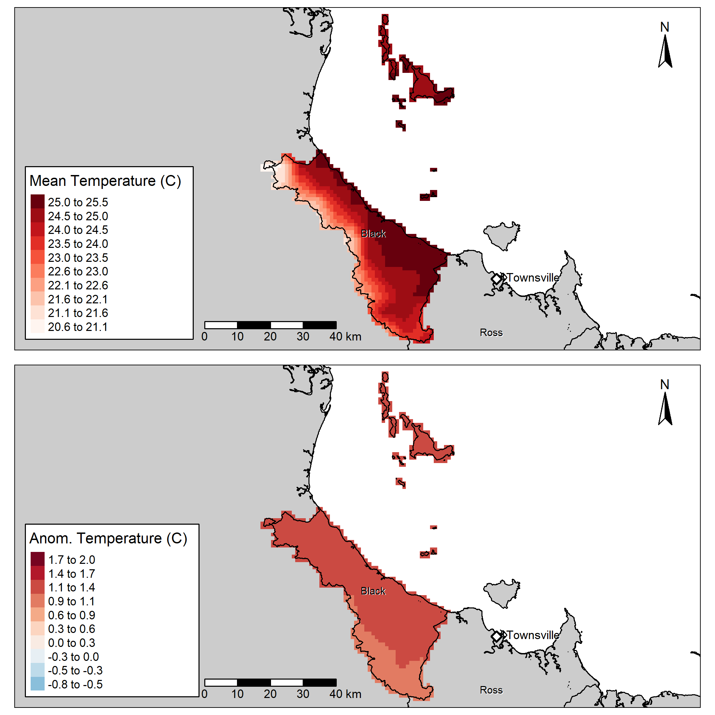
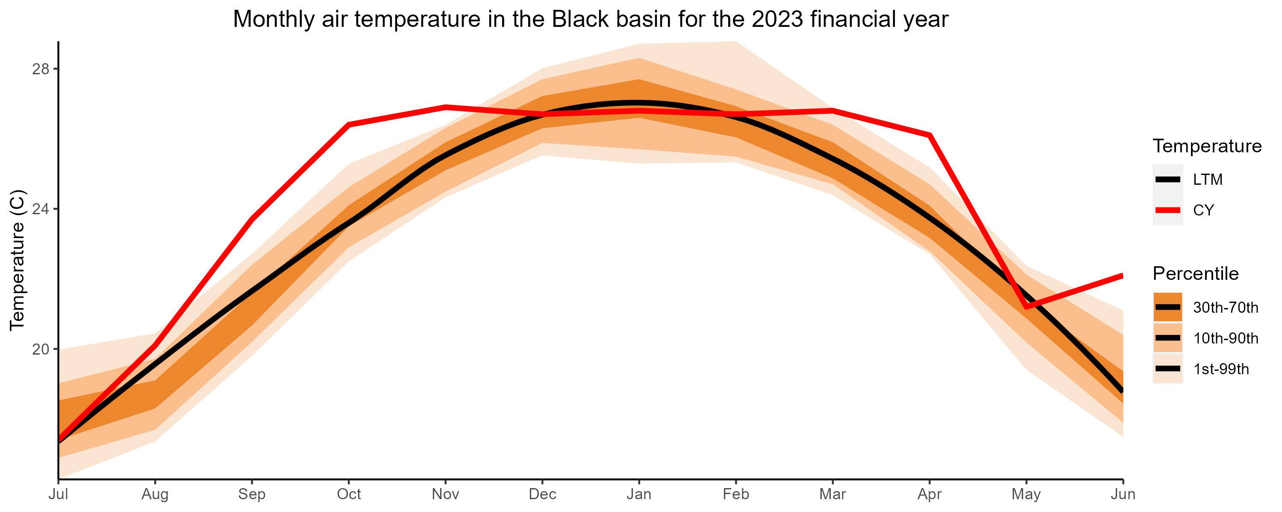
Another One,
Region | basin | Jul | Aug | Sep | Oct | Nov | Dec | Jan | Feb | Mar | Apr | May | Jun | Annual
Dry Tropics | Black | 3 | 6 | 7 | 7 | 7 | 4 | 4 | 4 | 6 | 7 | 4 | 7 | 6
Notes:
Keeping on the temperature theme.
We also look at air temperature.
Although the effects of air temperature on our data, such as water quality, fish, and habitat, can be quite subtle they still play a role.
And as I just noted, temperature also has the added benefit of being an extremely powerful communications tools.
For instance in the top right you can already see hints of the global warming trend just from 100 years of data.
In the map of the left you can very clearly see the temperature gradient from the hot coastline to the cool mountain ranges.
And in the graph on the bottom right you can see something particularly interesting about this year.
We found that the actual maximum temperatures recorded were quite normal, however these peaks before and after “summer” show that we had very long summer with a very extreme beginning and end.

Slide 21
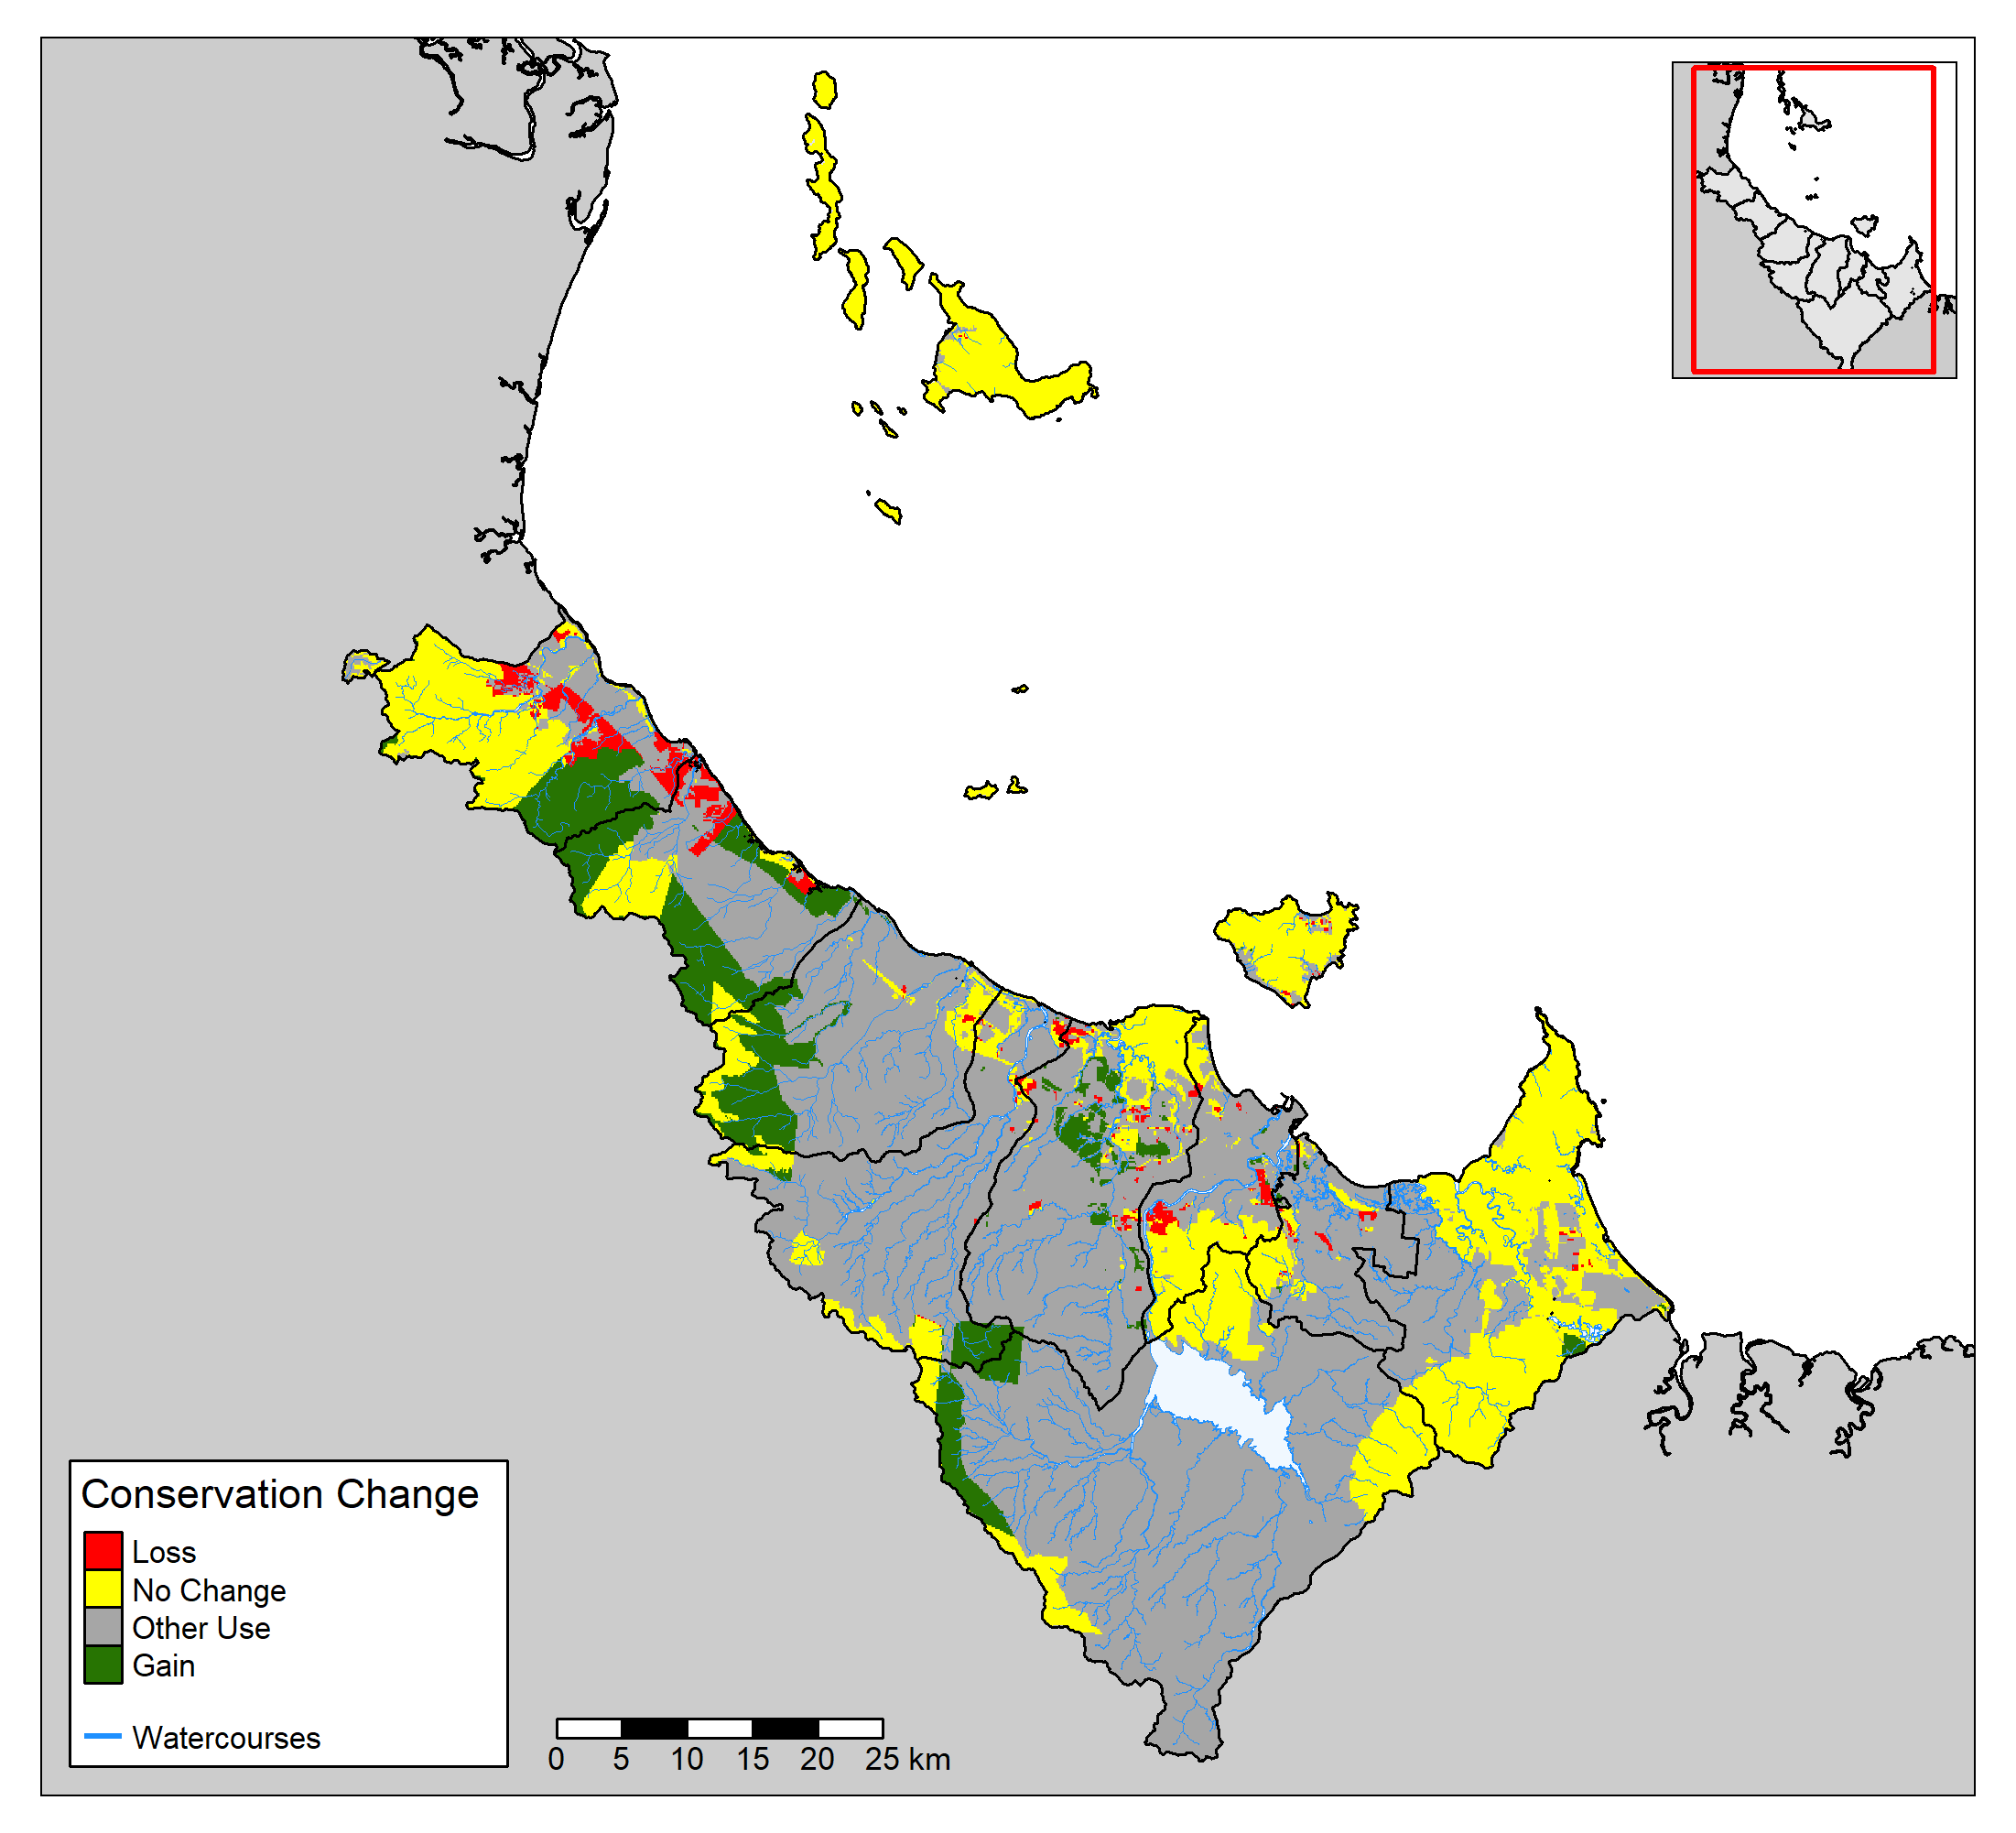
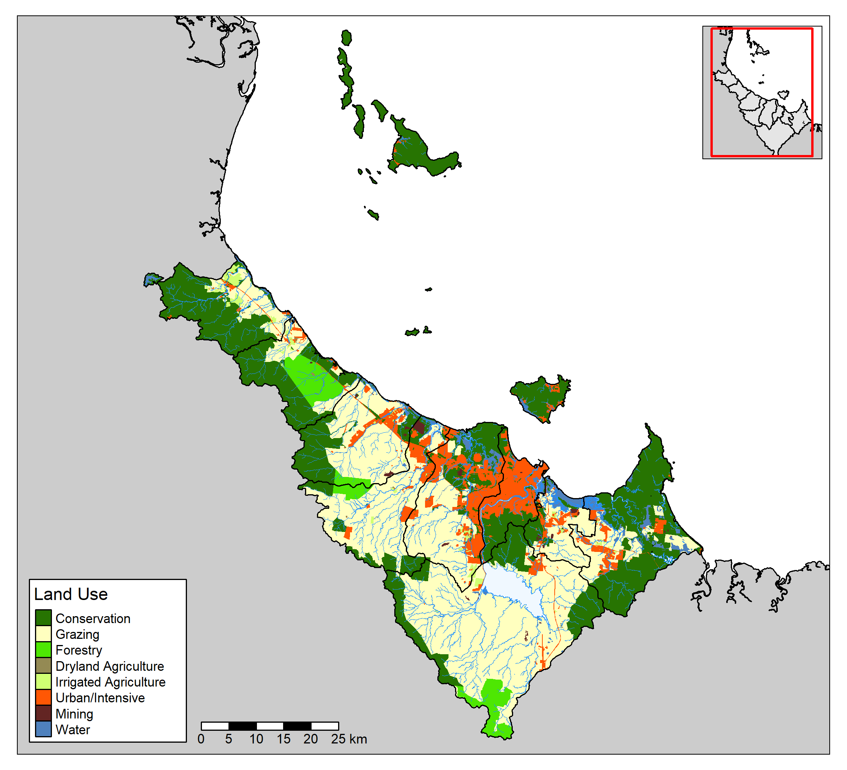
Another One,
Notes:
We also look at the types of land use that occur in our region.
This is particularly interesting for us as we have a significant area dedicated to urban develop or intensive urban uses.
You can see these coloured orange in the map on the left.
And of course, the wide array of land uses that occur in our region can have a direct impact on the environmental data that we receive.
From urban runoff, development, wastewater treatment, grazing, forestry, and even conservation land. All of them have an impact.
[CLICK]
We are also interested in how land use changes over time, and have developed maps that sort of looks at the cross product of each of the land use types between datasets.
On the right you can see that this map is focused on the conversation land use type, green is locations that have become conservation land since the previous assessment, red is land that is no longer conservation, yellow was conservation and still is conservation, and grey land has not been classified as conservation in either assessment.

Slide 22
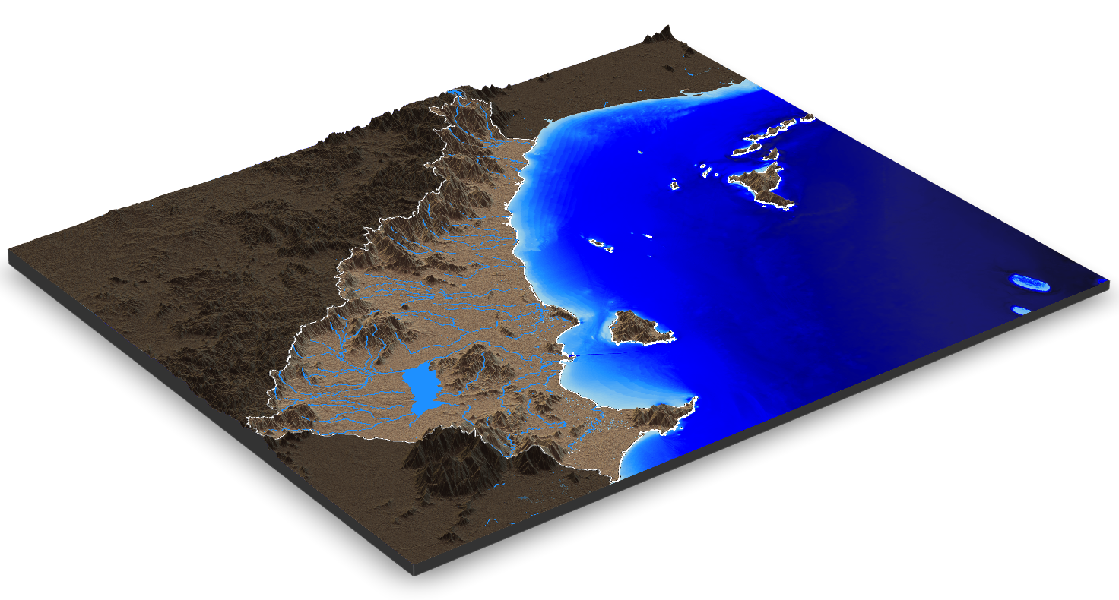
Spatial Adventures of the HWP
Digital Elevation Models
Effective communication of complex topics
Unique and motivating perspective of the region
Notes:
There are plenty more GIS products that we include in our technical reports and in our final report card, however I think you get the idea.
Lets move on to a few more adventurous GIS projects I am currently working on in hope that they will also one day be included in our flagship products.
[CLICK]
One such thing is the Digital Elevation Models – of which im fairly certain most people in the room would have heard of.
Which is actually quite refreshing!
Although not directly used in our flagship products, these 3D models allow use to effectively communication interesting and complex topics with the public.
In the case of the image on the right, we used the DEM as tool to explain how water flows from the ridge to reef.

Slide 23
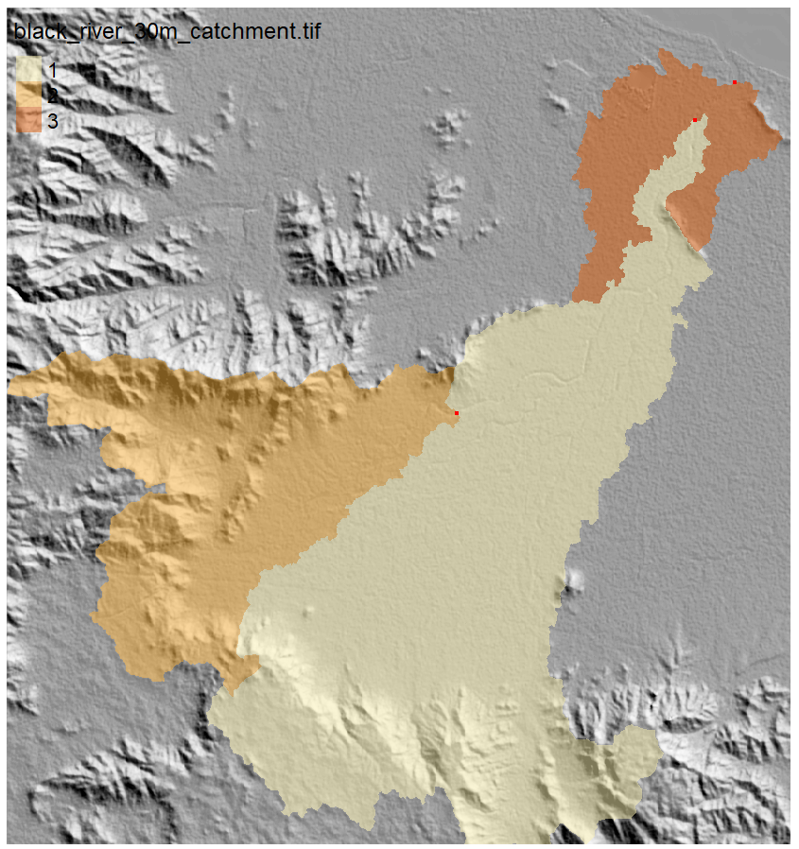
Spatial Adventures of the HWP
Notes:
However, we are also looking at using the DEM data to establish custom catchment boundaries for each of our sample sites.
It is a bit hard to see but each of the shaded areas have a small red dot at their most downstream point.
These red dots each represent a sample site.
Using the custom catchment boundaries, for every one of our sample points we would be able to calculate:
Exactly how much rainfall occurred in the catchment
Exactly what landuse types are upstream
Exactly what type of vegetation, and how much, are upstream,
You get the idea.
This would improve and enhance our capacity to explain and identify key drivers of our data,
It would improve our confidence and understanding of the results
And it would allow for easy visualisation and communication with the public.

Slide 24
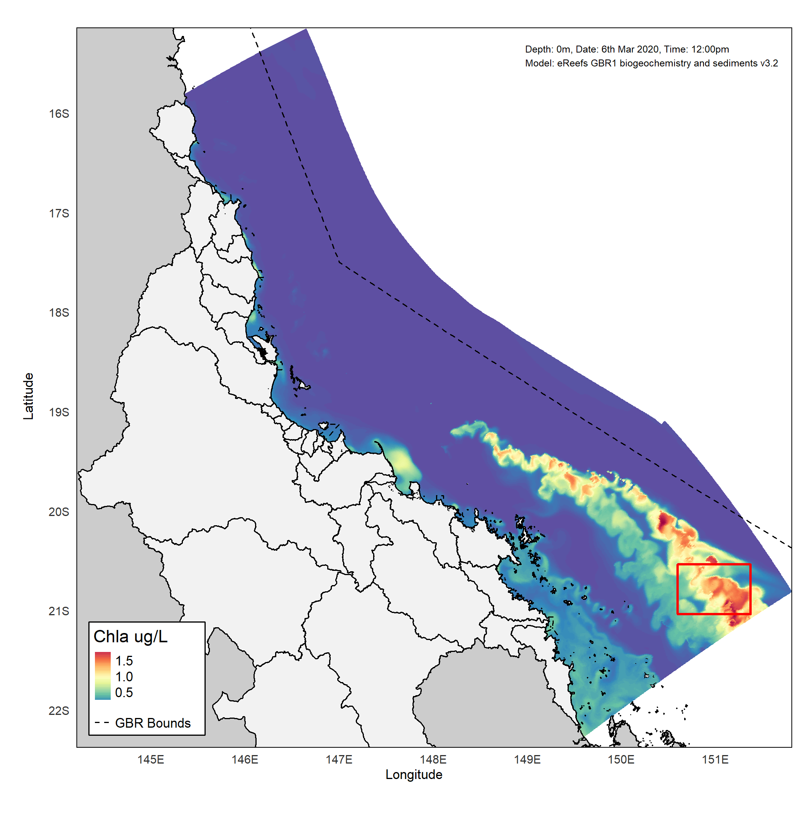
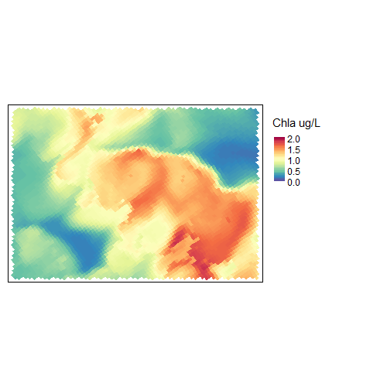
Spatial Adventures of the HWP
Investigating alternative data sources
Satellites
eReefs (a modelling product from AIMS)
Notes:
But what about offshore, so far, a lot of my work has occurred on land.
And there is a reason for that, land is easy to get to, easy to record data about.
Its not just my work either, despite receiving more than 27,000 data points from several different providers, we have very little data in our offshore marine environment.
So I have turned to GIS to explore alternative data sources to fill these gaps.
[CLICK]
These include information from satellites, and from the eReefs project, which is a collaboration between the Australian Government, the Australian Institute of Marine Science, the Bureau of Meteorology, and CSIRO.
This map was created using data extracted from eReefs and shows modelled Chlorophyll a levels across a section of the Great Barrier Reef.
We are particularly interested in these types of data sources as it is quite difficult to get regular samples so far offshore.
So we are looking to satellites and models to obtain the information.
For a sense of scale, the location in which the animation is playing is about 200km offshore. That’s a long way for a water sample.

Slide 25
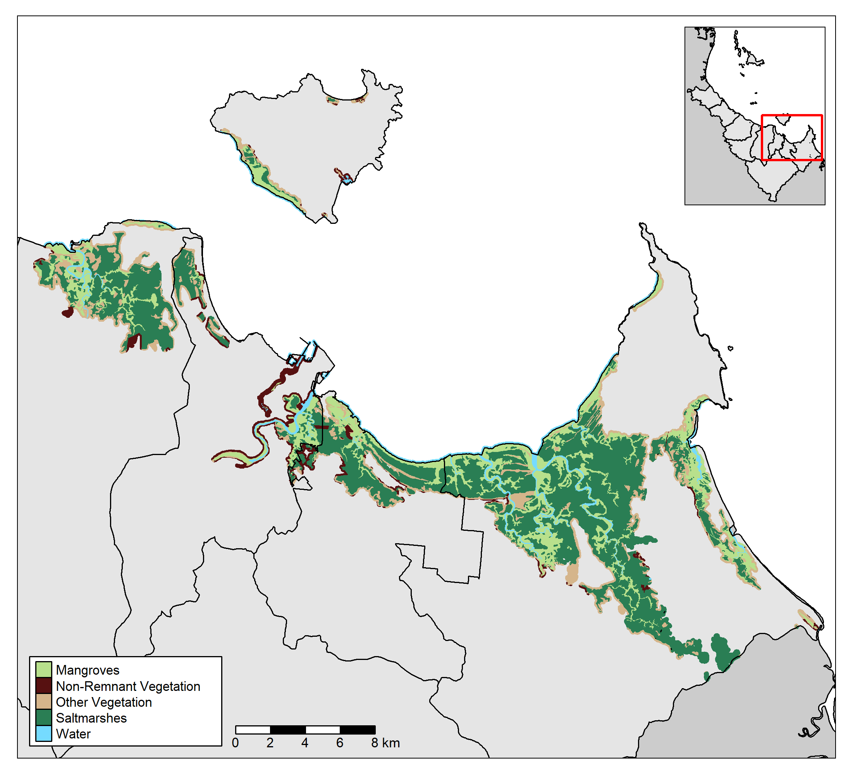
Spatial Adventures of the HWP
Automated spatial analysis
Fish barrier detection
Riparian vegetation change
Notes:
One of the final areas of GIS we are interested in at the Healthy Waters Partnership is the automation of certain workflows.
I’m sure many of you can relate to the idea of repeating the same task over and over again.
And that’s something that we are trying to deal with as well.
I know this map doesn’t look like much, but is a small part of a workflow I have been creating that will detect and highlight vegetation changes in our data.
Another workflow I have been working on, and I currently have an intern testing for me, is a fish barrier identification and prioritization workflow.
My goal with these workflows is to create end-to-end tools that my team will be able to use with very little technical knowledge.
And wouldn’t you know, that is another great segue to my next section!

Slide 26
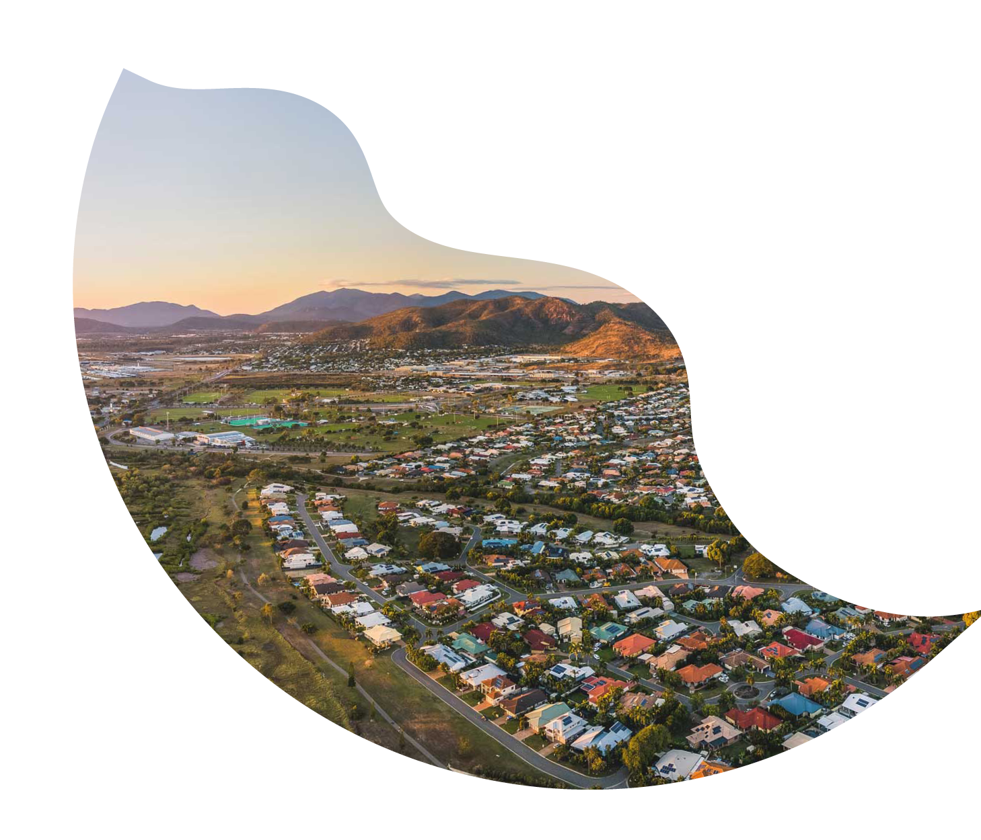
GIS To The *Masses (*Where masses = RRCN)
Notes:
GIS to the Masses
Now while this is all well and good, for some people, it is all just techno mumbo jumbo. They are not interested in GIS, or the intricate technical details.
And that fine, they don’t have to be interested.
But it is our job to ensure they at least understand the importance.
And that brings me to the next stage of my talk. How do I get the entire Regional Report Card Network, (that’s all five groups) to embrace this work.

Slide 27
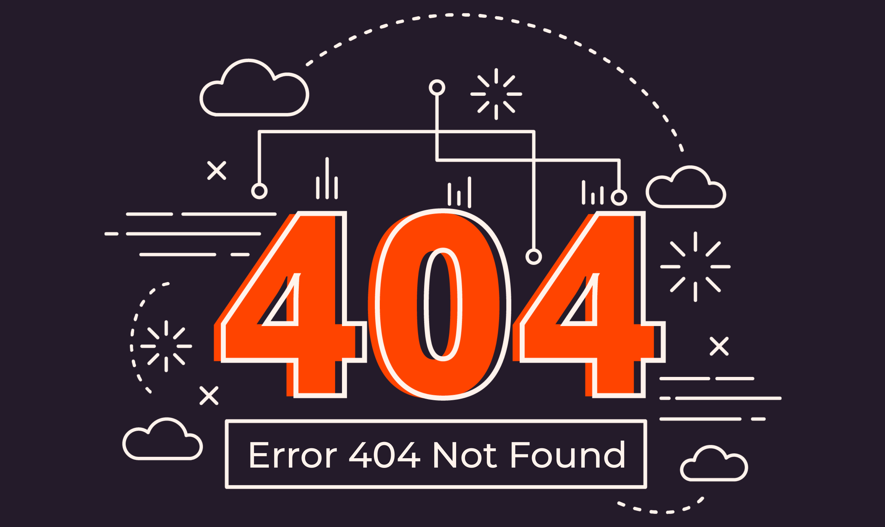
“That GIS Person”
A mystery of the modern age
Notes:
Picture this for a moment.
“That GIS person”
I’m sure many teams are familiar.
For the first few years at the Healthy Waters Partnership this was our reality.
We relied heavily on “that GIS person”… except they weren’t even in our organisation!
[CLICK]
And pretty much all the GIS work I just presented didn’t exist.
For climate we would take screenshots from the BOM website, and our analysis extended no further than the broad generalised comments BOM made about annual climate for North Queensland.
For topics such as fish barriers and vegetation we would ask our partners really nicely if they could do the analysis for us.
And for the exploratory work I have been doing with eReefs and Digital Elevation Models – well that just wasn’t happening.
But we did have site maps!

Slide 28

“That GIS Person”
Does not equal:
Notes:
Although where we are now is quite the improvement, integrating GIS into the Report Card world is still mostly a case of “that GIS person over there does it for me”.
Except now that GIS person is me.
Which is fine, that makes me feel like a valuable part of the team.
But what happens when I leave?
Do we go back to begging our partners to help?
I don’t like the sound of that.

Slide 29
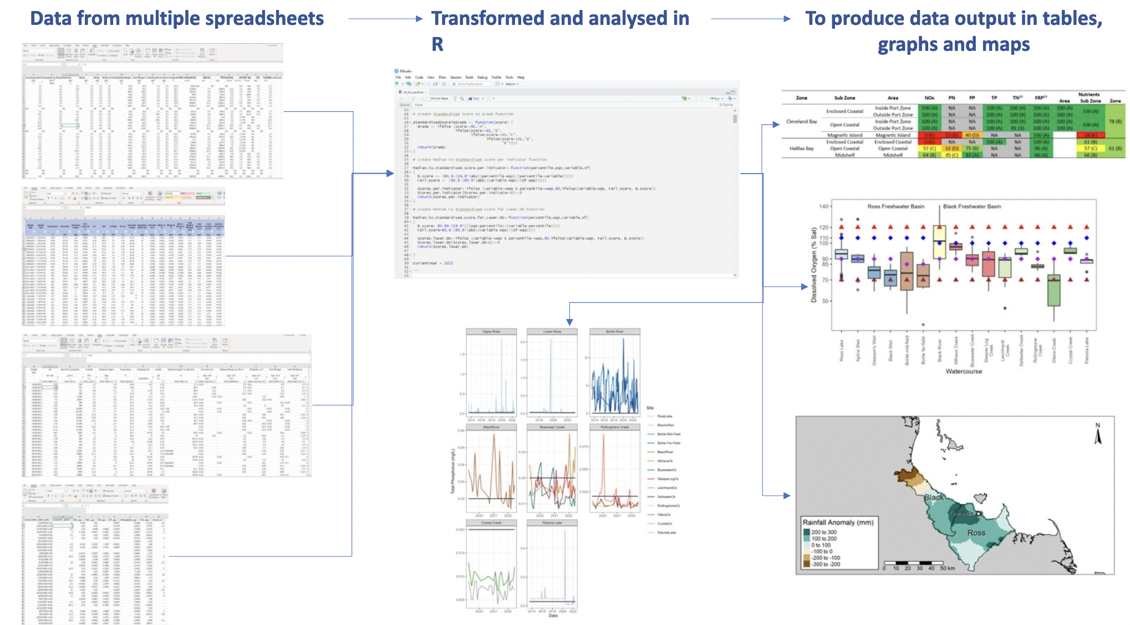
a cReative solution – meet them at home
Many of the technical staff across the RRCN have skills in the programming language R.
So, I have done all spatial analysis work in R.
Notes:
So the way I am bringing GIS to the regional report card network is to meet them “at home” so to speak.
I said earlier in my talk that one key skill shared by the technical team at each organisation is the programming language R.
And this image shows a common workflow that the technical officers would undertake.
So instead of introducing yet another tool they would need to learn.
[CLICK]
I simply conducted all spatial work in R.
With respect to the previous workflow that the technical team have been completing, all that is required is one additional output.

Slide 30



a cReative solution – familiarity
This makes the work familiar and easier to utilise for the other teams.
Each of the teams can run the analysis themselves.
R also allows for robust method scaling with little effort.
Notes:
By introducing GIS to the technical team within R, rather that by using an entirely new program such as ArcGIS or QGIS.
[CLICK]
I can make many of the new processes and requirements feel familiar.
[CLICK]
Instead of relying on someone (me) to do the GIS work, and fix things when they go wrong, they would be able to do it themselves.
I can still write all the GIS specific code, but they have the skills and background to be able to run it and fix it as needed.
[CLICK]
And one of the best things about R is its ability to scale, once I write the analysis for the Healthy Waters Partnership, it can be easily scaled to each of the other teams.

Slide 31
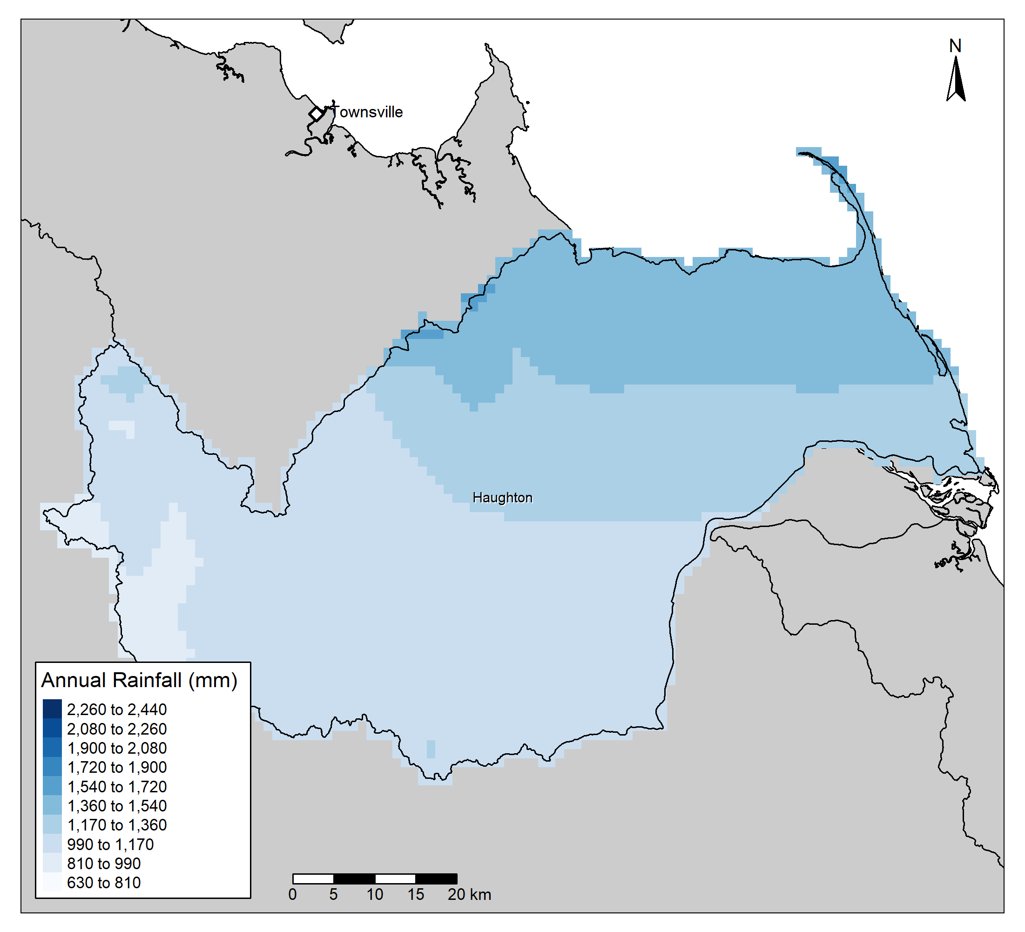
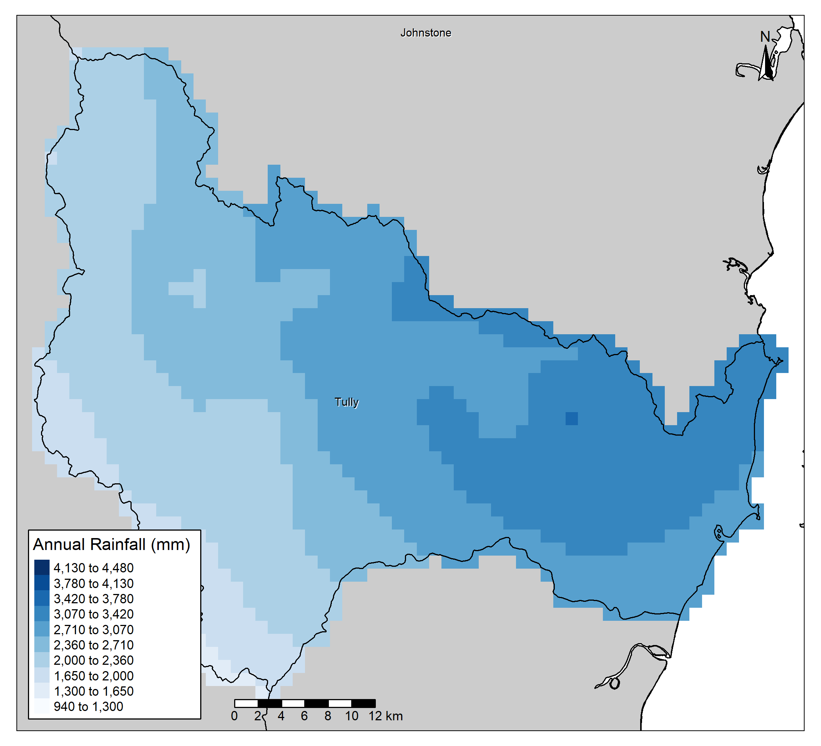
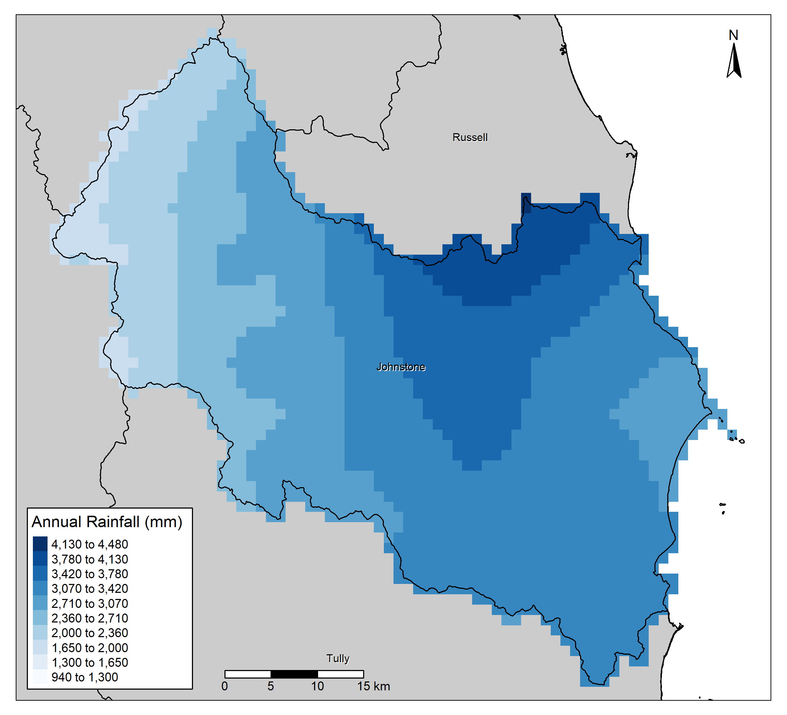
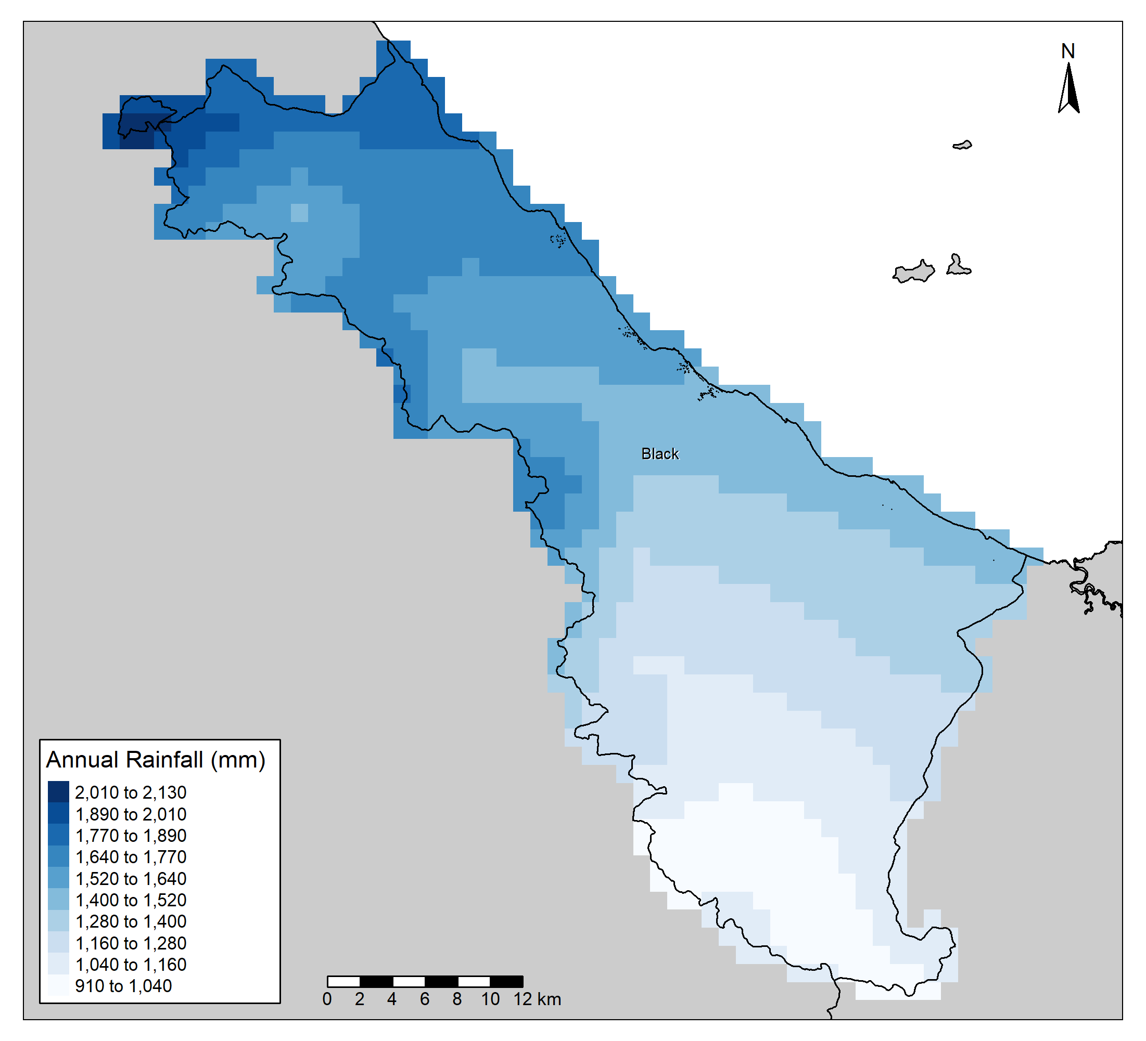
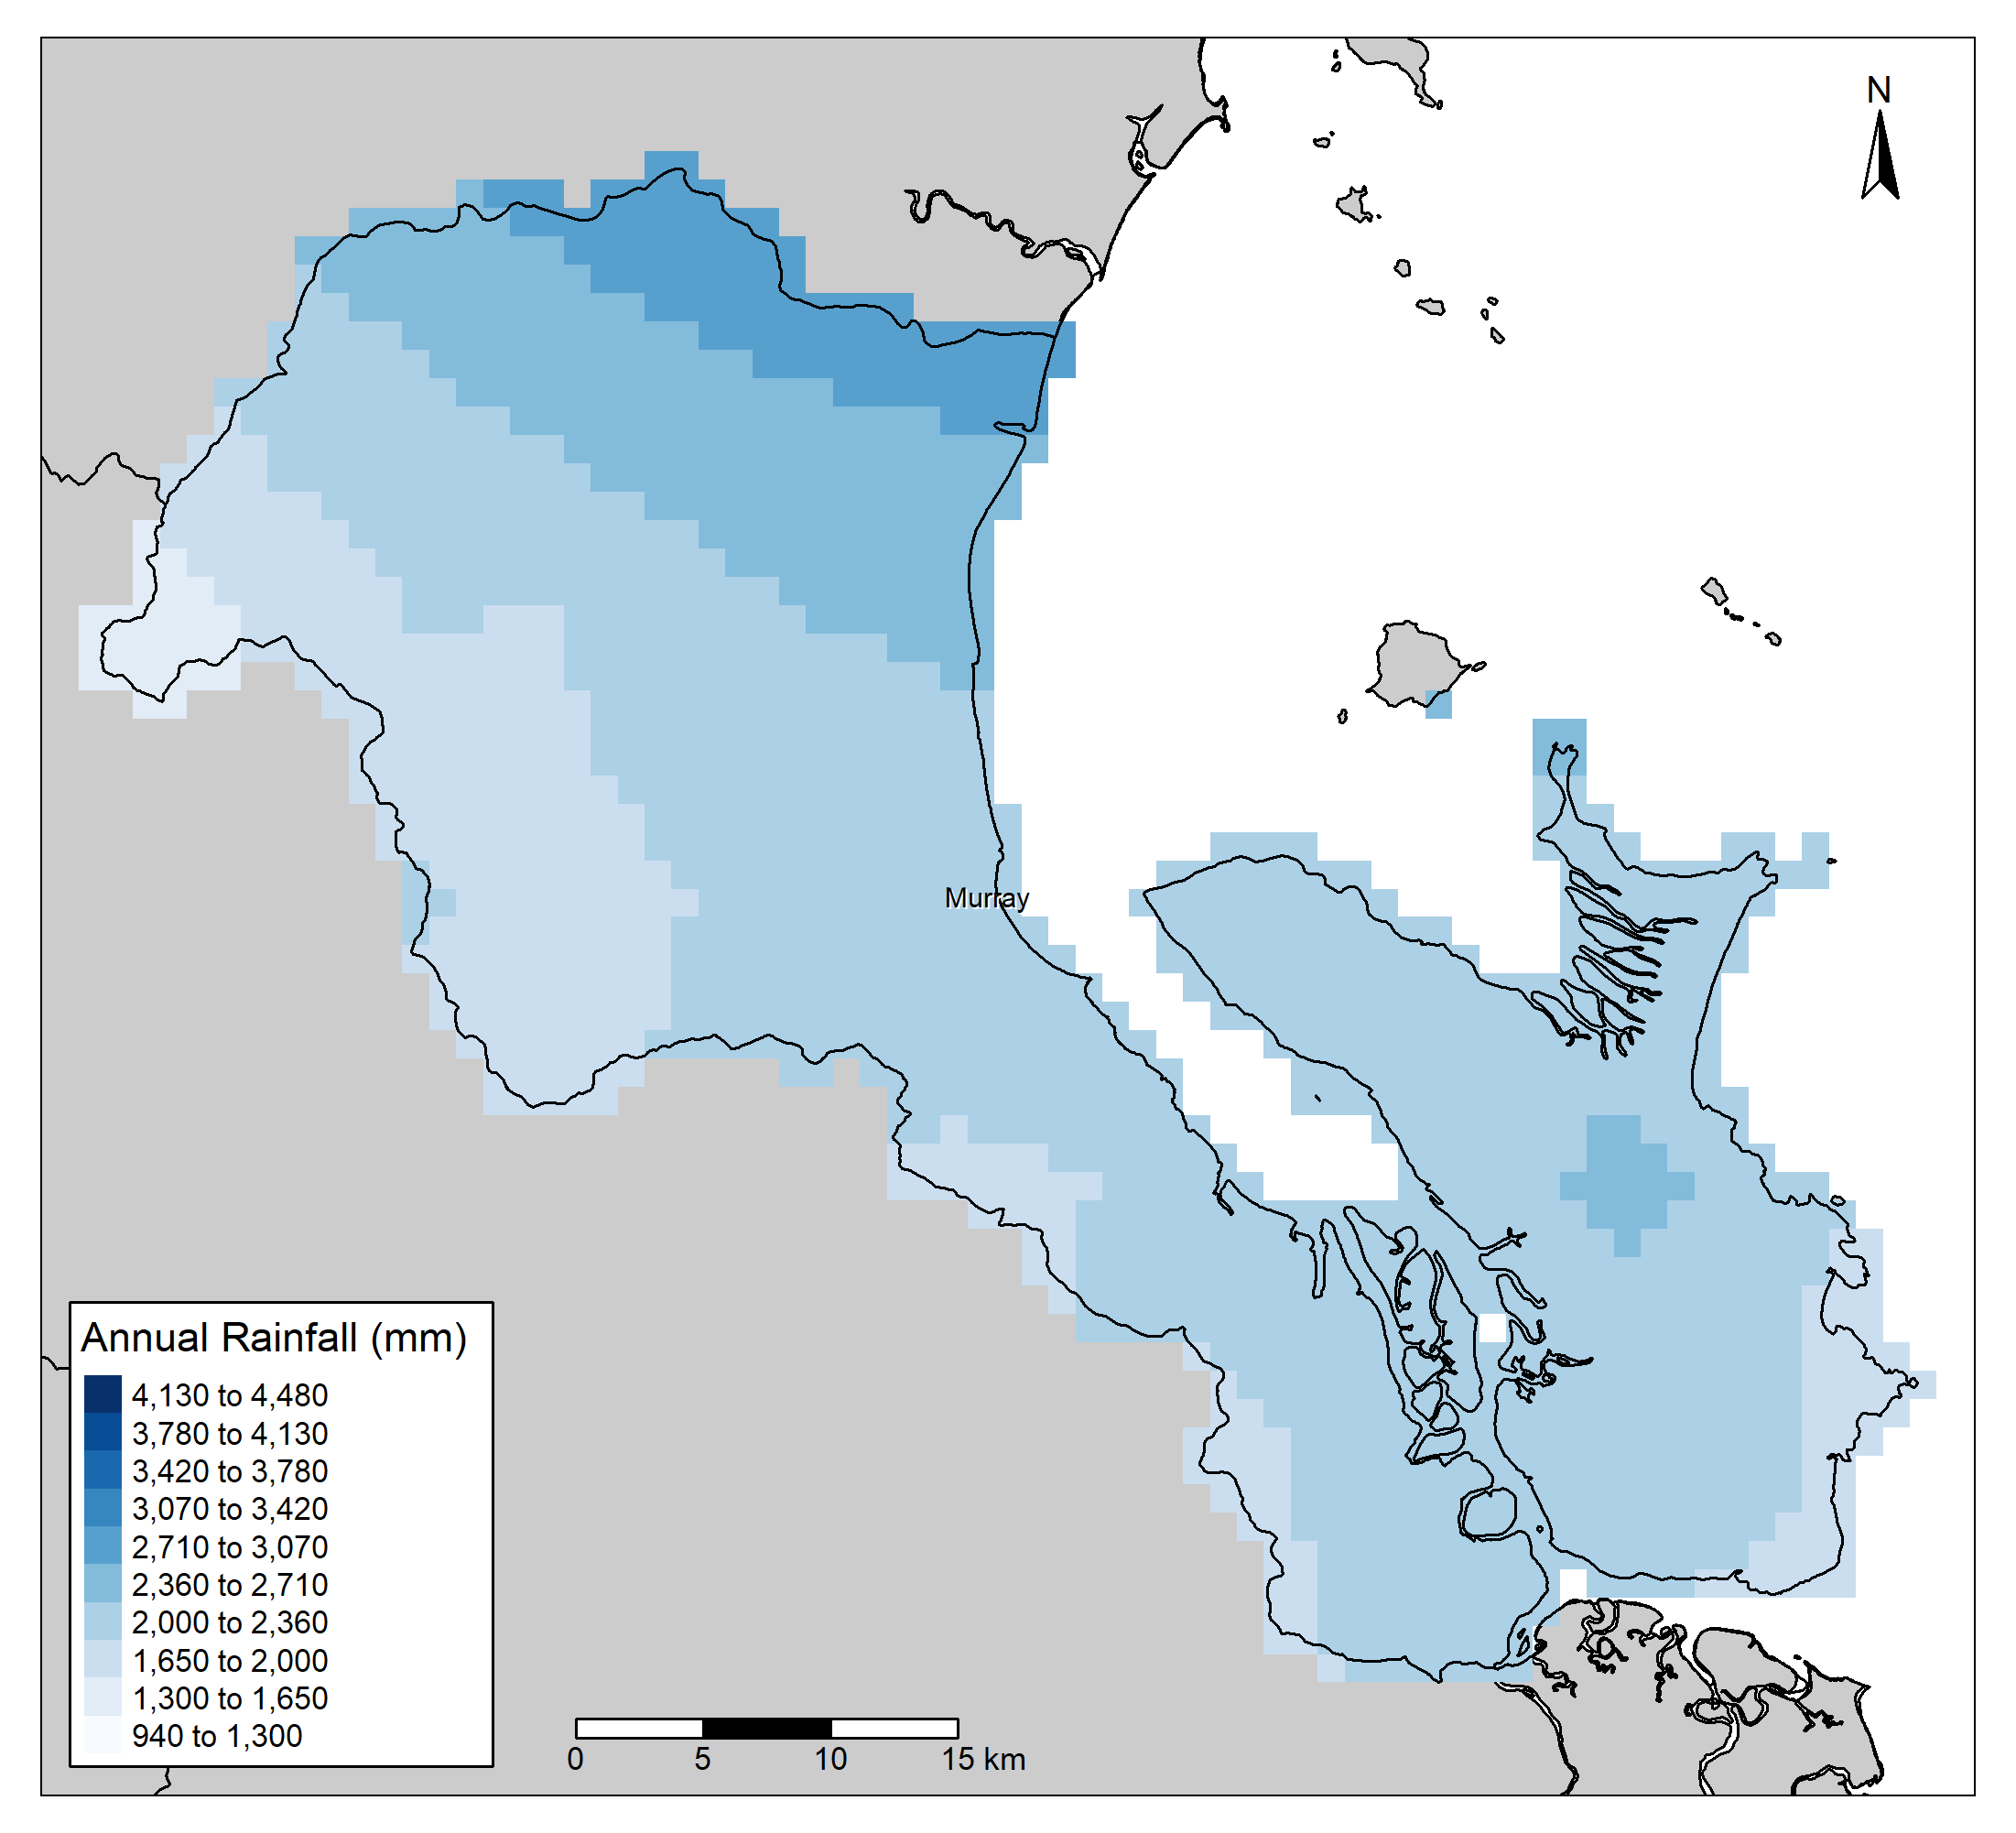
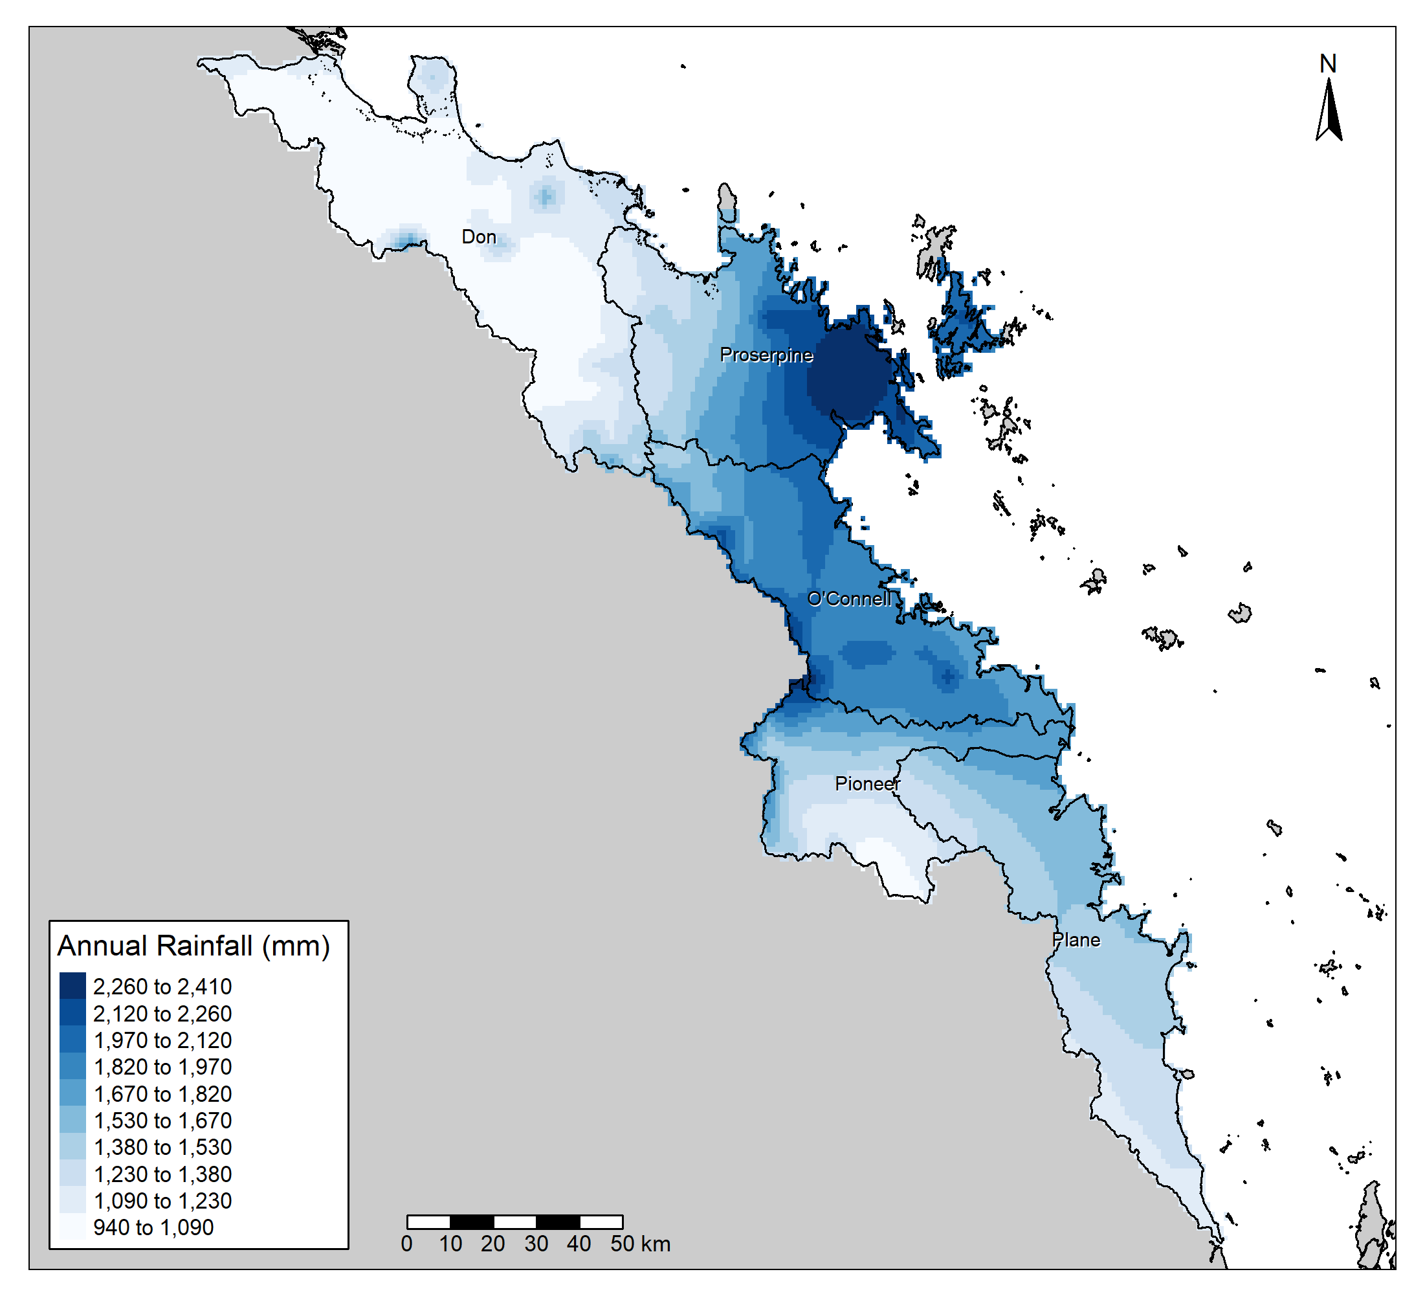
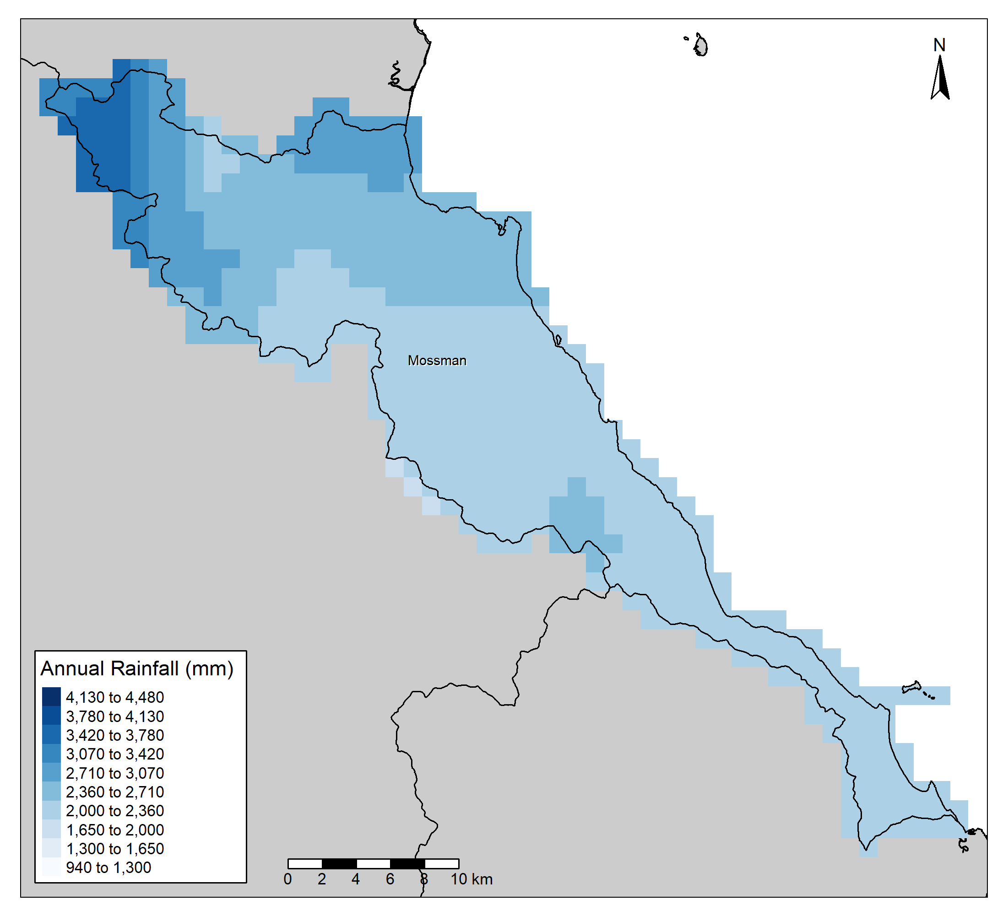
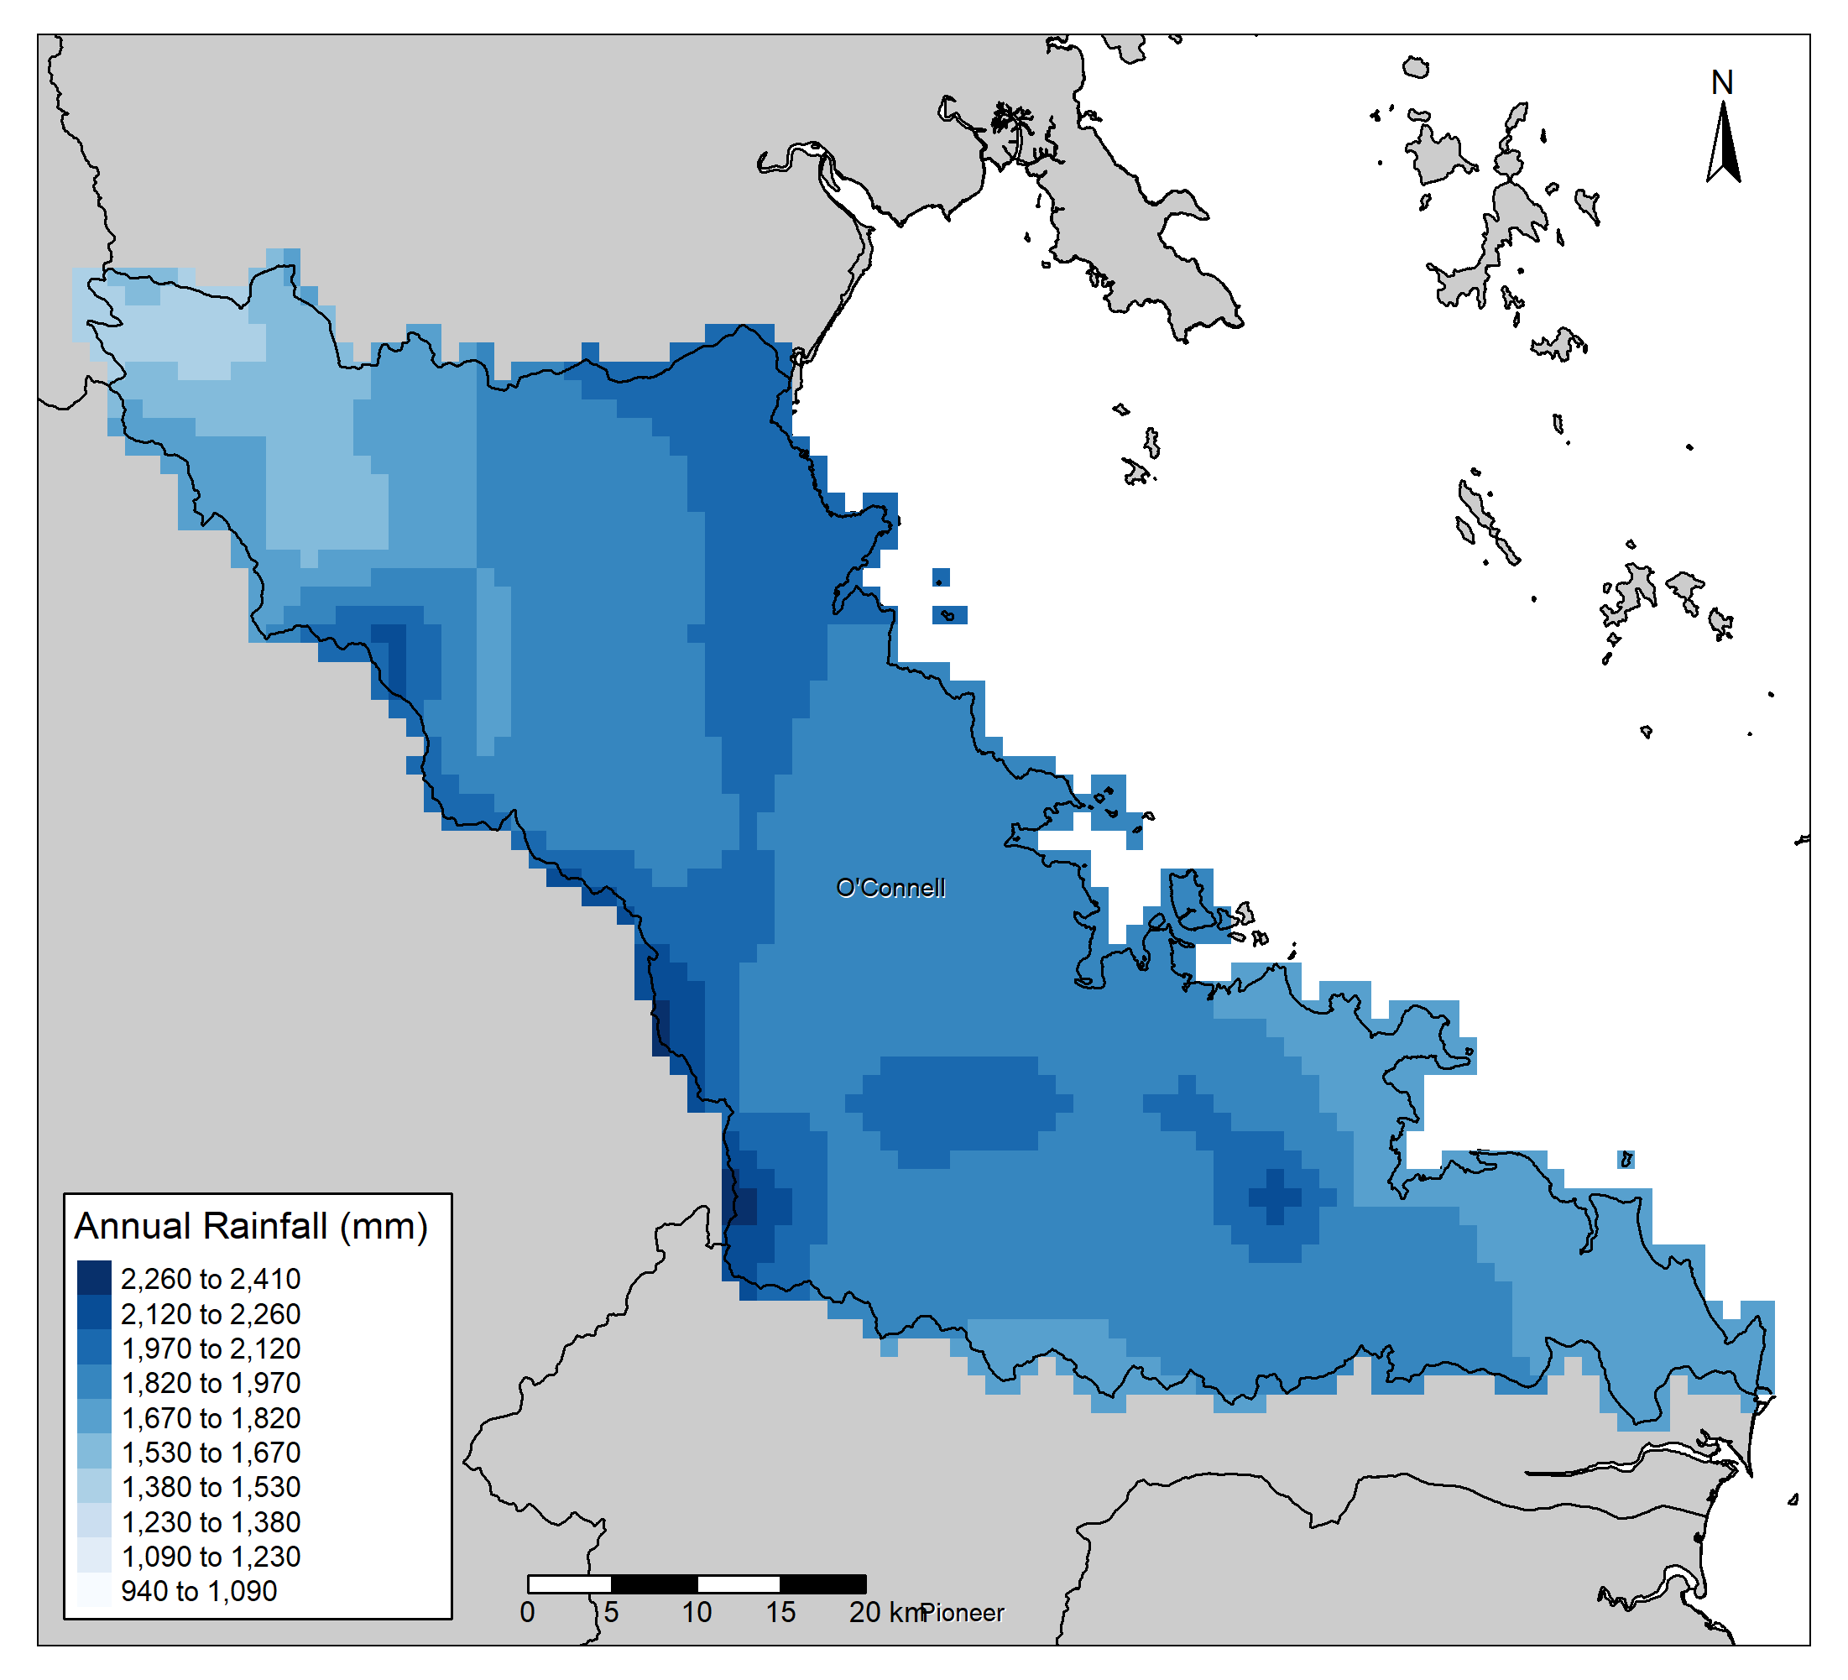
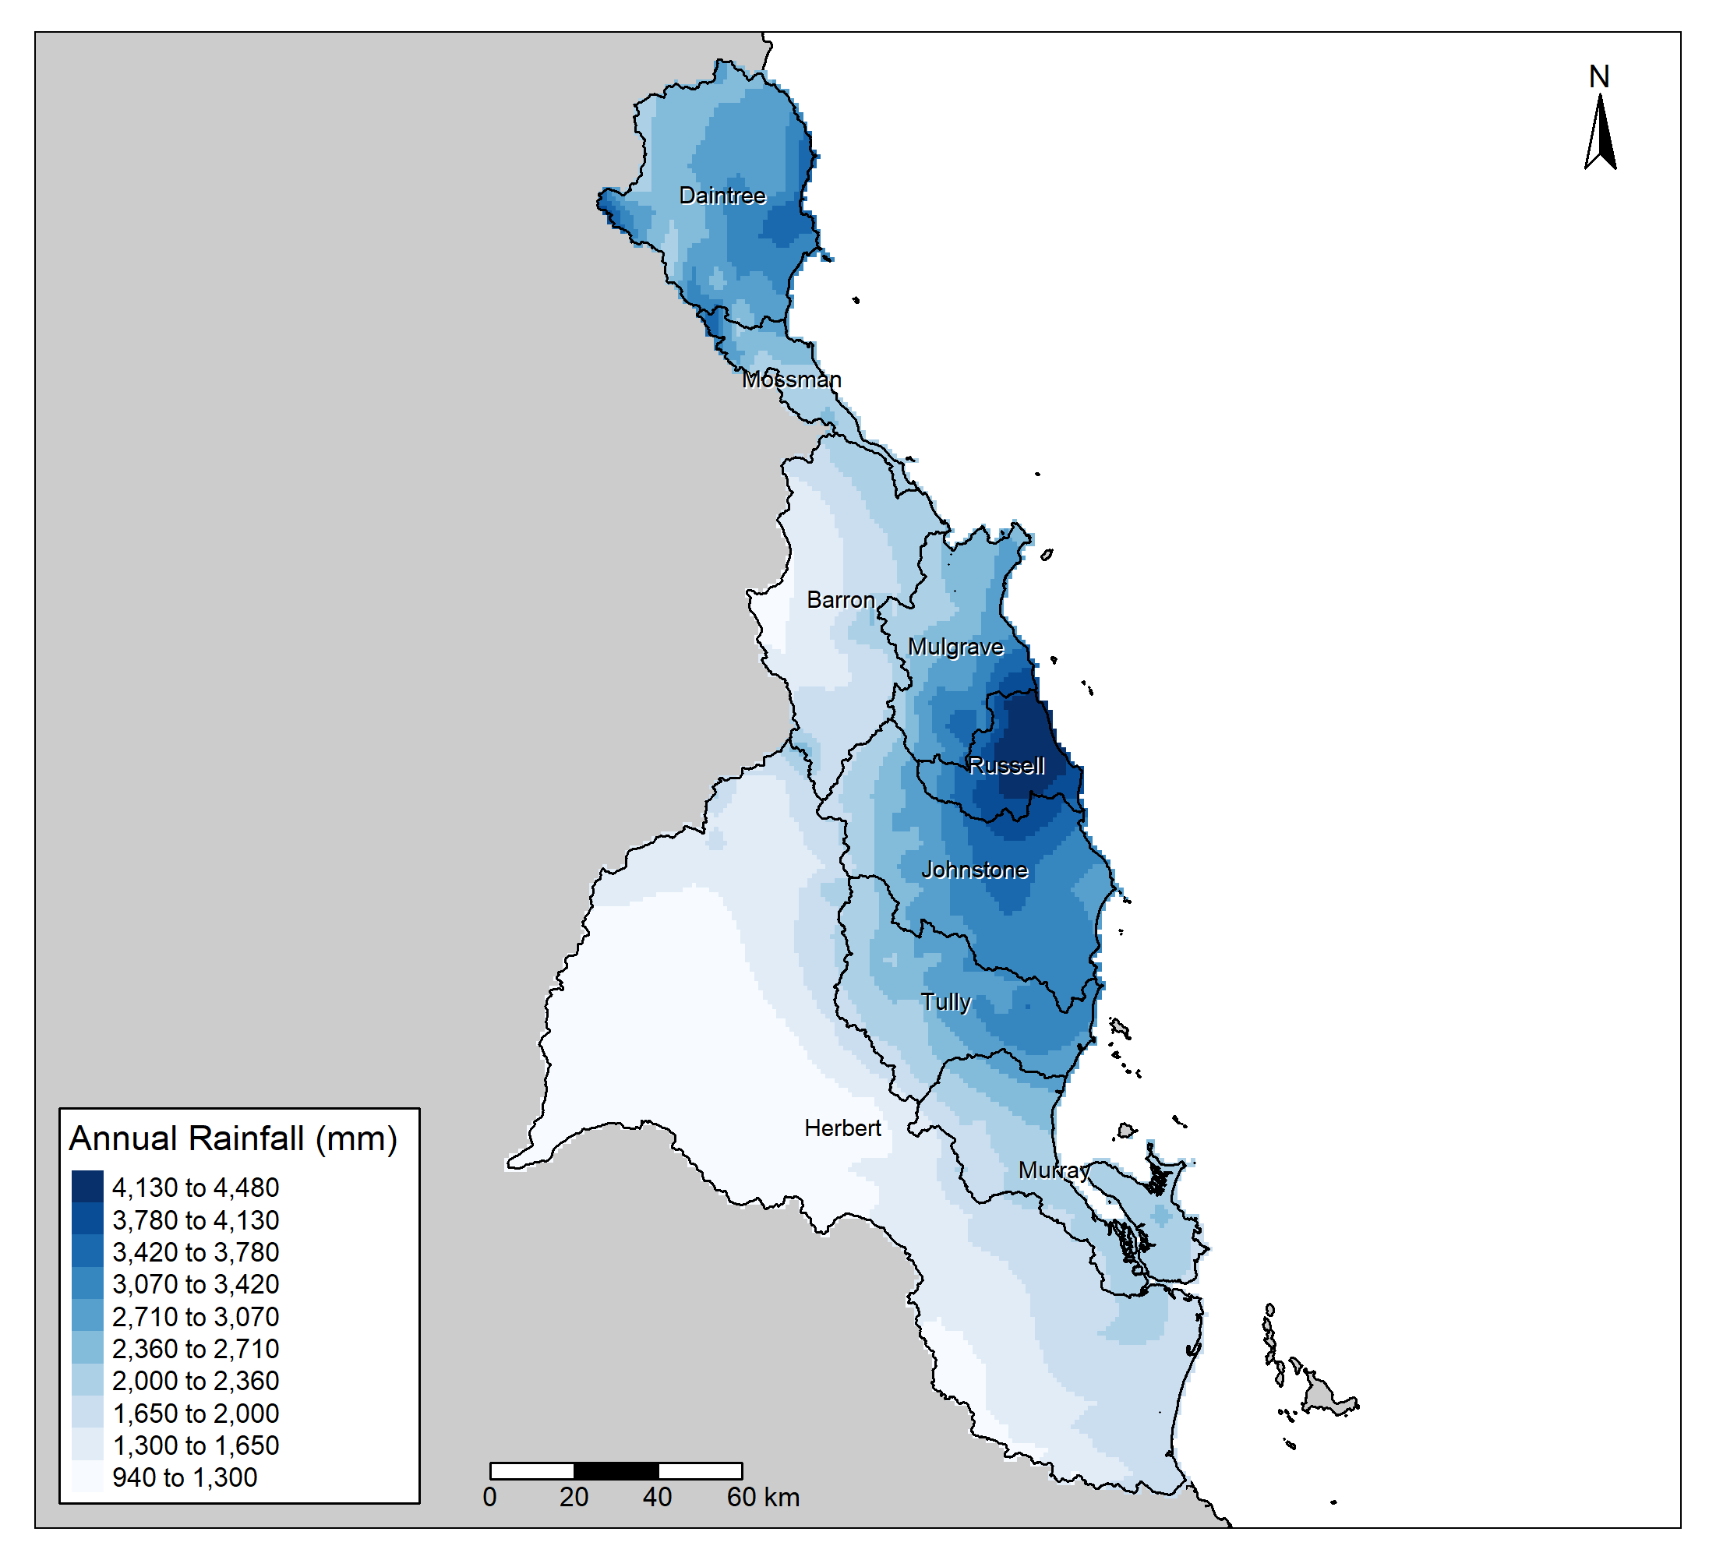
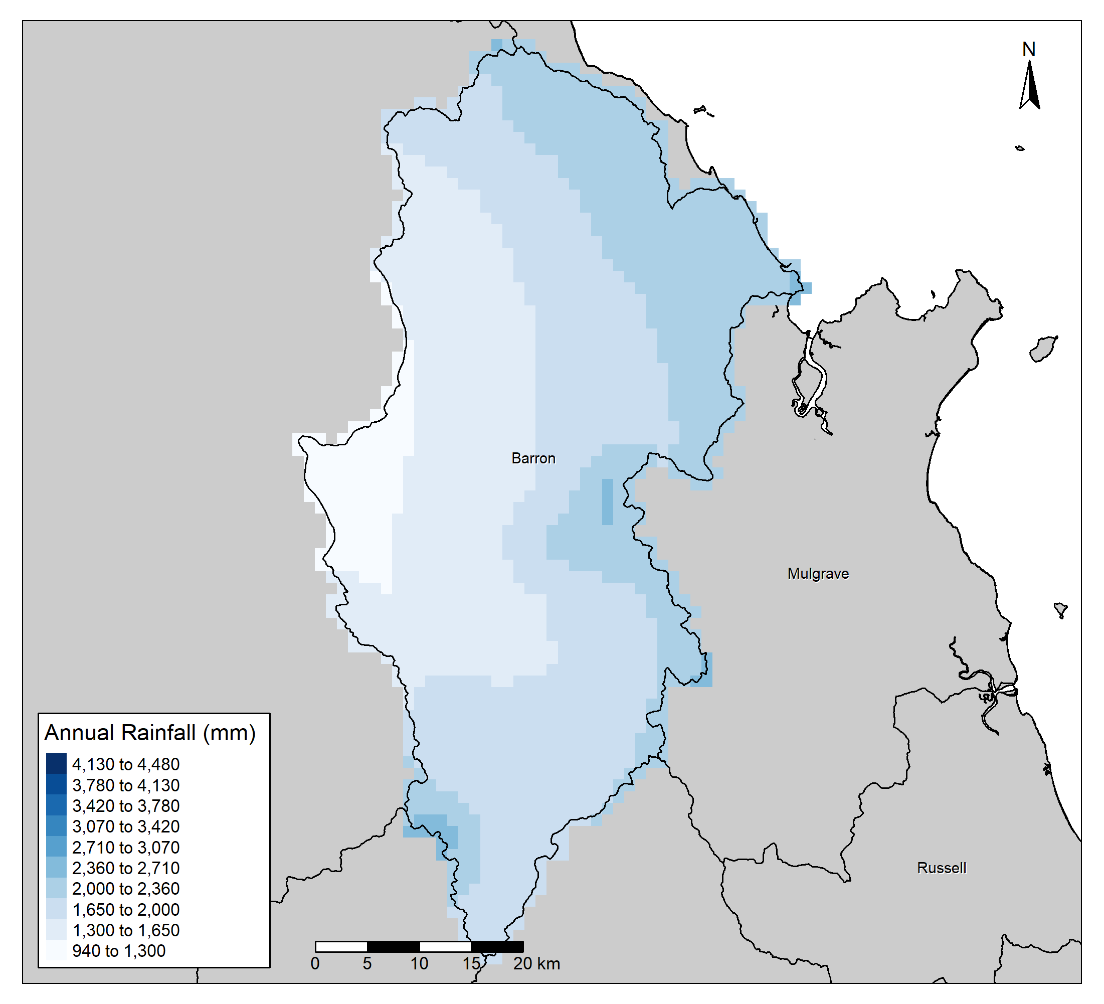
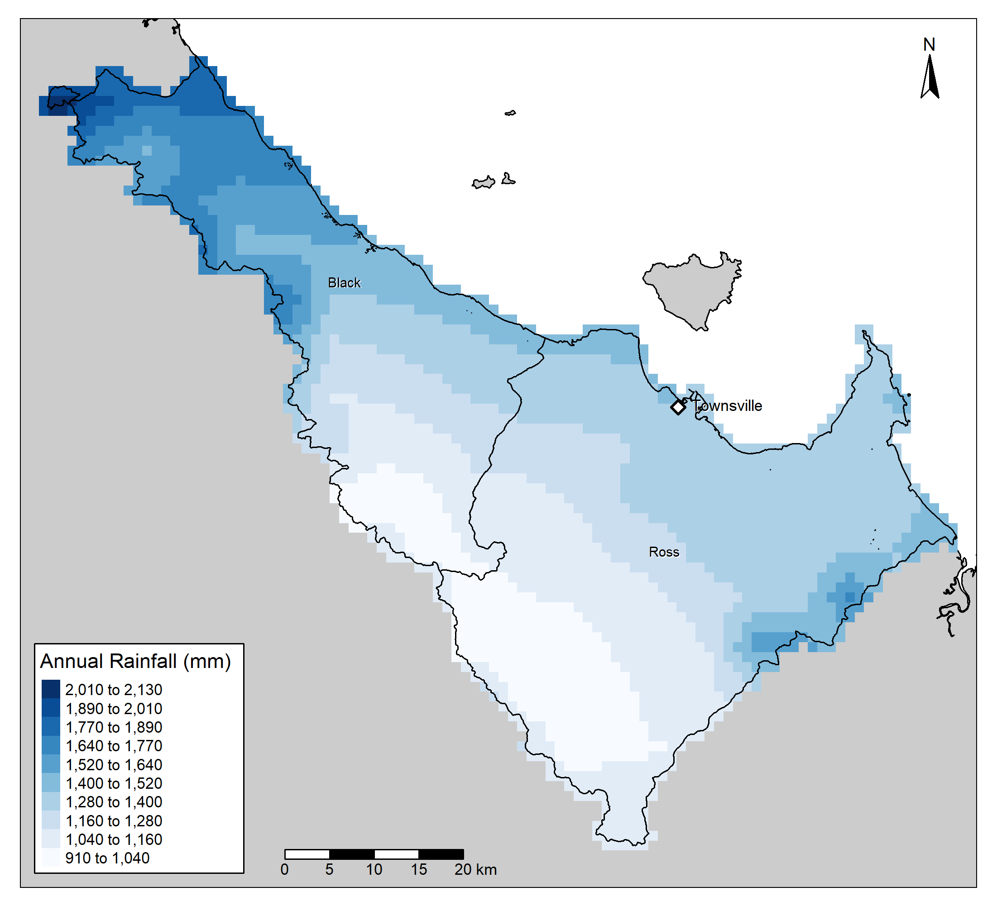
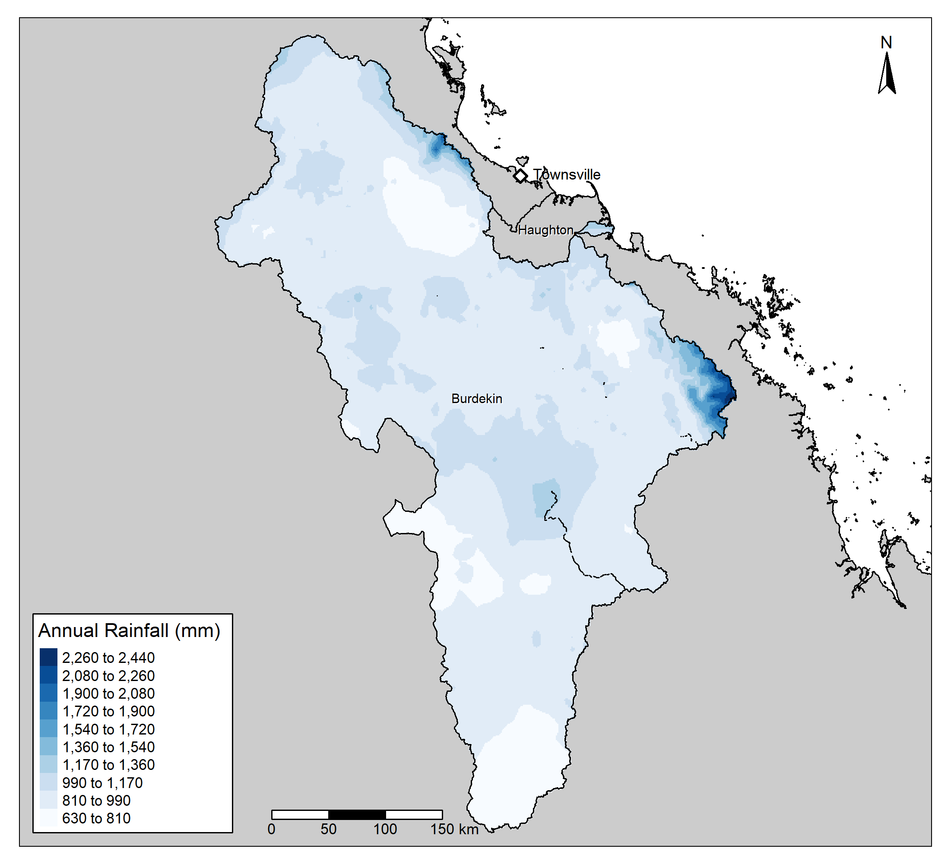
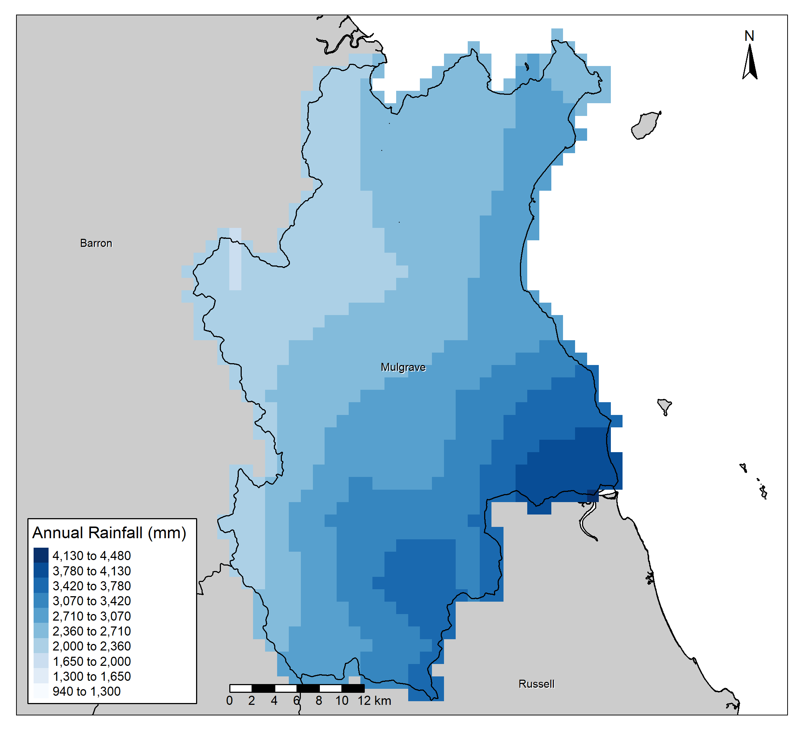




a cReative solution
Rapidly
Reproducible
...woRk
Notes:
And to expand on that last point about rapidly, reproducible work. That can easily scale.
The scaling has already been completed.
[CLICK]
I now create all of these maps for all of the different partnerships with just one click of a button.

Slide 32


















a cReative solution
Rapidly
Reproducible
...woRk
Notes:
Along with these.

Slide 33

















a cReative solution
Rapidly
Reproducible
...woRk
Notes:
And these.
Plus every other analysis that I have already presented.

Slide 34


The Technically Disinclined
“Grandma needs help”
- Kara, every day.
Notes:
But what about those even more “technically disinclined”.
I bet you can think of someone.
In the regional report card network, that would be team members who don’t have GIS knowledge OR R knowledge.
For me, its my boss Kara.
Who rightfully so, is not particularly interested in GIS as she is to busy leading the entire organisation.
And if you think I made this quote up, this was her on Tuesday.
[CLICK]
So anyway, how can we show them the power of GIS, and how we can use GIS to enhance the impact of each of the partnerships.
In that case, the Healthy Waters Partnership still has one more ace up its sleeve.
We use the good old StoryMap.

Slide 35


Notes:
The Healthy Waters Partnership currently has a collection of several StoryMaps.
Unfortunately I have run out of time to walk you through in detail about these StoryMaps, however if you are interested you can find links to each on our website.
We use these StoryMaps as a communicative tool, they are excellent at engaging the public and telling an interesting story about what is otherwise a potentially very boring topic.
So far we have published a StoryMap on the Hydrology and Hydrodynamics of Cleveland Bay.

Slide 36


Notes:
a StoryMap on the secret life of seagrass in Cleveland Bay.

Slide 37


Notes:
And are currently in the works to create a corals of Cleveland Bay StoryMap. – Stay tuned for that one.

Slide 38

Conclusion
Notes:
In conclusion I can whole heartedly say that GIS is a fantastic tool for communicating complex information in a format that is palatable and relatable.
We use GIS tools nearly every day at the Healthy Waters Partnership. For everything from highly detailed technical analysis, all the way to interactive stories designed to entertain.

Slide 39
Notes:
I would just like to thank all of our partners, as they are the backbone of this Partnership. From the provision of data to the provision of expert knowledge, without them none of this would be possible.
I would also like to thank the rest of the Healthy Waters Partnership team, they truly are some incredible people.

Slide 40

For more information visit
drytropicshealthywaters.org
Or contact me directly
to@drytropicshealthywaters.org
Notes:
If you are ever in the Townsville region and would like to get involved, visit our website and contact us.

